Slide 1
AI-Enabled Social Cyber Maneuver Detection and Creation
Matthew Hicks
Thesis
22 April 2025
Committee
Kathleen M. Carley, Chair
Patrick S. Park
Mohamed Farag
David M. Beskow (United States Military Academy)
Notes:
Folder – All source code Graduation checklist
Include –
Full suite and tie Attire PHD in the current age
Dress something –
COL Beskow
Leave that running
Stop Recording
Mihovil -> Zoom RECORD

Slide 2
Outline
Introduction
Background/Doctrinal BEND
AI-Enabled BEND Scenario Development
Generating Synthetic Data for BEND Training
BEND-Effects and Improving the BEND Framework
Conclusions

Slide 3
Social-Cyber Security
BEND provides a framework for describing information space maneuvers
BEND allows us to frame:
(Source) Who
(Payload) Maneuver
(Target) On Whom
(Effect) Impact
Narrative Maneuvers |  |  | Network Maneuvers
Impact what is being said and how it is being said |  |  | “Community” maneuvers. Alter who is connected to whom, the strength of those connections, and so alters who is influential and what groups exist
Emotional Messaging | Develop Narrative | Counter Narrative | Individual Centric | Make Groups | Unmake Groups
Excite | Explain | Distort | Back | Build | Narrow
Dismay | Engage | Dismiss | Negate | Bridge | Neutralize
 | Enhance | Distract |  | Boost | Neglect

Slide 4
Major questions and motivation
Q1: How does the BEND framework fit into current US military doctrine and how can it enhance current information environment analysis?
Q2: How can we develop exercise training scenarios for the BEND framework?
Q3: How can we create synthetic data w/ BEND maneuvers to support a training scenario?
Q4: How can we detect the presence of BEND maneuvers through their effects? Can we tie these effects to broader social media campaigns?

Slide 5
Purpose
The purpose of this thesis is to:
Develop applications and methods for creating social media training scenarios that are realistic by leveraging generative AI
Develop applications and methods for creating the synthetic social media datasets through the use of generative AI that match a tailored scenario while mirroring real world data
Develop methods for detecting the effects of BEND maneuver within topic groups and connect these effects to broader campaigns
AESOP
SynTel/X
BEND-effects
Notes:
The purpose of this thesis is to move BEND beyond a theoretical discussion framework and into an operationally relevant construct for evaluating social-cybersecurity; this is is accomplished by nesting BEND within current US military doctrine, identifying countermeasures to BEND maneuvers, connecting detected maneuver effects with broader BEND campaigns, and ultimately leveraging AI to develop synthetic training scenarios that closely mirror real word data with minimal human intervention.

Slide 6
Doctrinal BEND

Slide 7
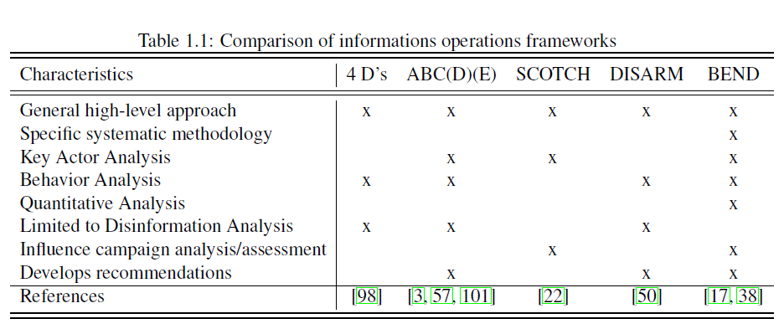
Prior Work
Blaine (CMU-S3D-23-102) looked at and compared BEND to four other frameworks.
Compared BEND to four other information operations frameworks:
Ben Nimmo: 4Ds
ABCDE Framework
Camille Francois: ABC Framework
Alexandre Alaphilippe: ABCD Framework
Pamment: ABCDE Framework
Blazek: SCOTCH Framework
DISARM Foundation: DISARM Framework
BEND’s strength is in its shorthand
Notes:
he ABCDE Framework Actor What kinds of actors are involved? This question can help establish, for example, whether the case involves a foreign state actor. Behavior What activities are exhibited? This inquiry can help establish, for instance, evidence of coordination and inauthenticity. Content What kinds of content are being created and distributed? This line of questioning can help establish, for example, whether the information being deployed is deceptive. Degree What is the overall impact of the case and whom does it affect? This question can help establish the actual harms and severity of the case. Effect What is the overall impact of the case and w
S – Source
C – Channel
O – Objective
T – Target
C – Composition
H – Hook DISARM-STIX for disinformation objects, including actors, behaviours, narratives and artifacts - this makes it easy for DISARM data to be passed between ISAOs and similar bodies using standards like TAXII.
DISARM Red for disinformation creation behaviours
DISARM Blue for disinformation countermeasure and mitigation behaviours.
Disinformation Analysis & Response Measures

Slide 8
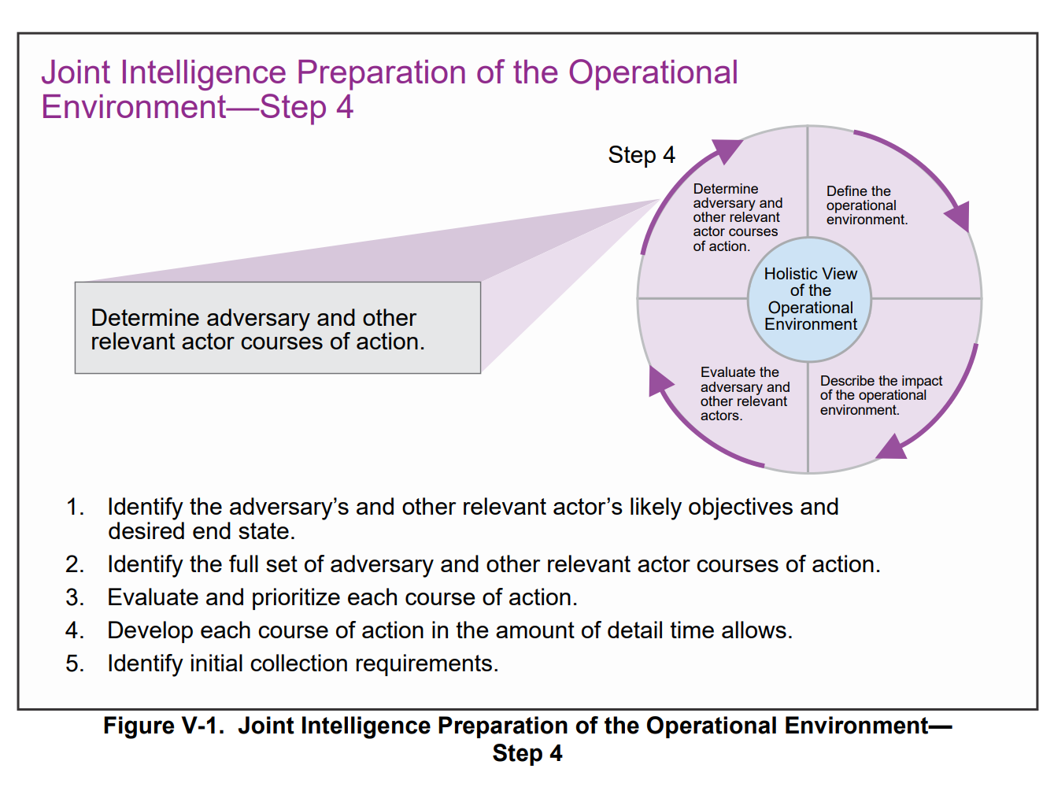
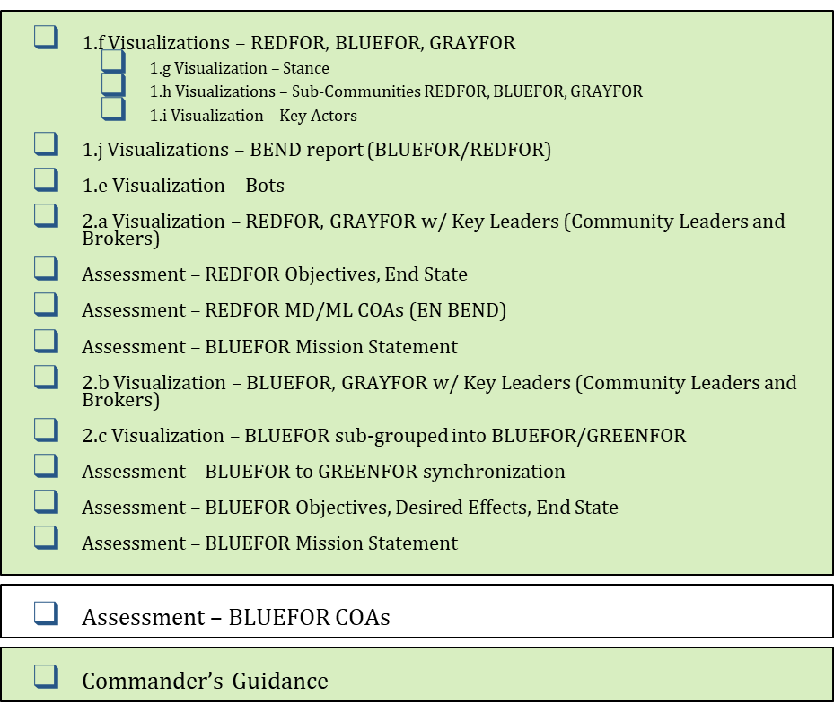
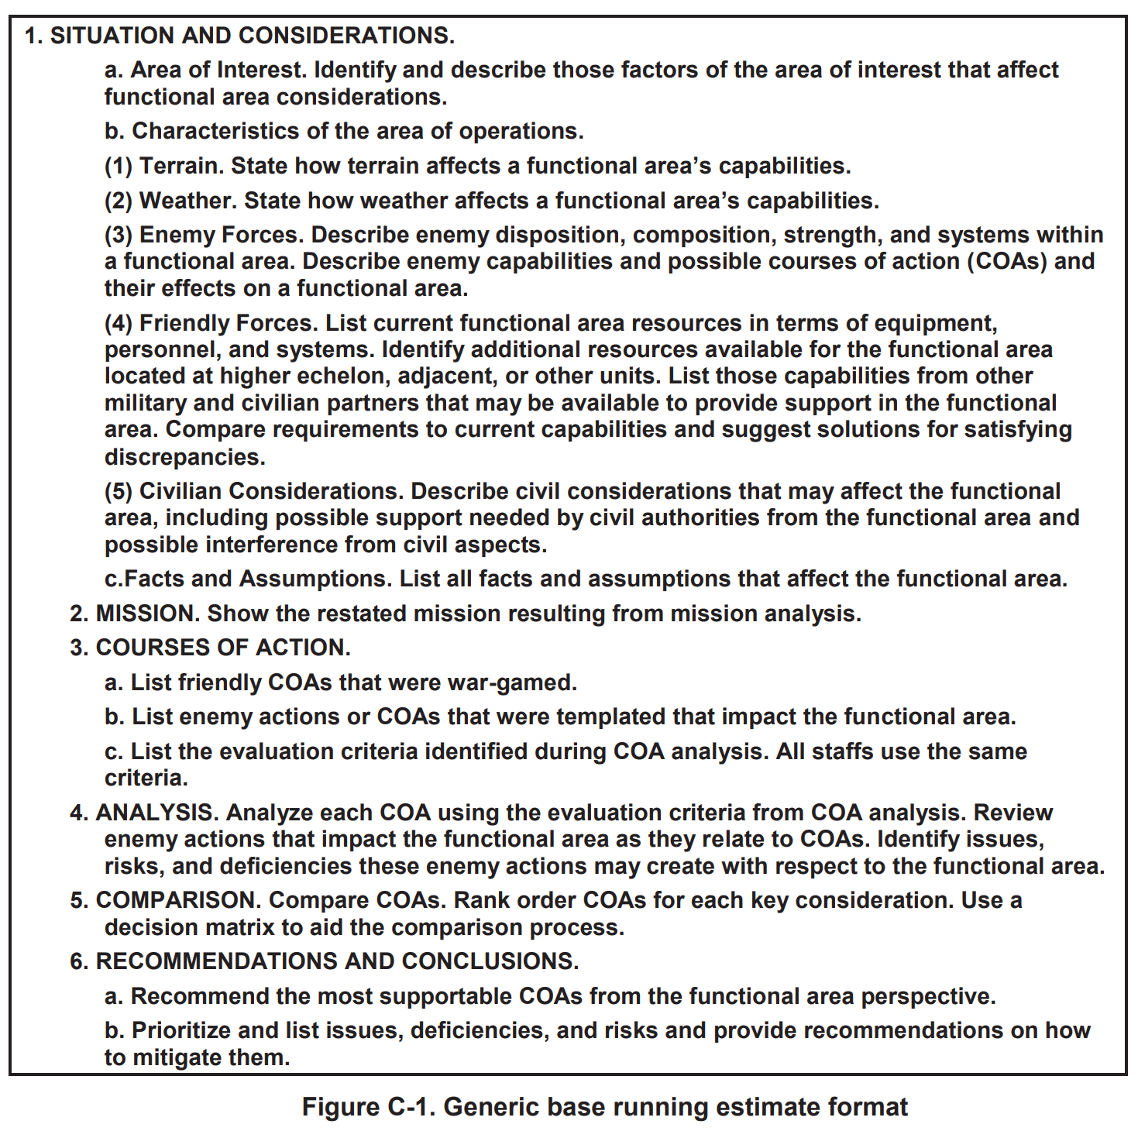
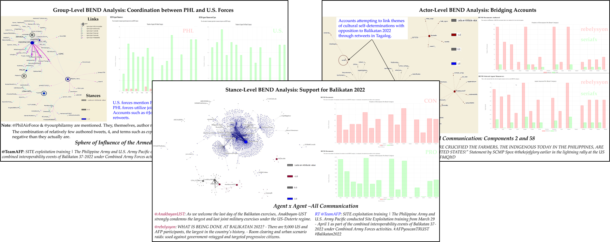
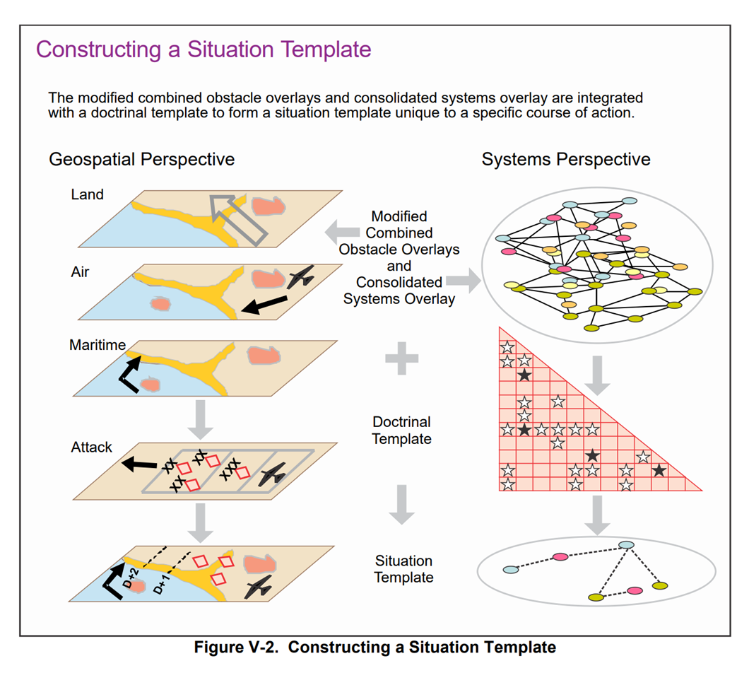
How does the BEND framework fit into current military doctrine?
Current References
Current Products
New References and Products
JP 3-04 Information in Joint Operations
JP 3-13 Information Operations
NWP 3-13 Navy Information Operations
FM 3-13 Information Operations
AFDP 3-13 Information in Air Operations
CJCSI 3210.01C Joint Information Operations Proponent
DODI 3600.01 Information Operations
ADP 5-0 The Operations Process
MCWP 3040.4 Marine Air-Ground Task Force Information Operations
JP 2-01.3 Joint Intelligence Preparation of the Operational Environment
ATP 2-01.3 Intelligence Preparation of the Battlefield
JP 3-60 Joint Targeting
…

Slide 9
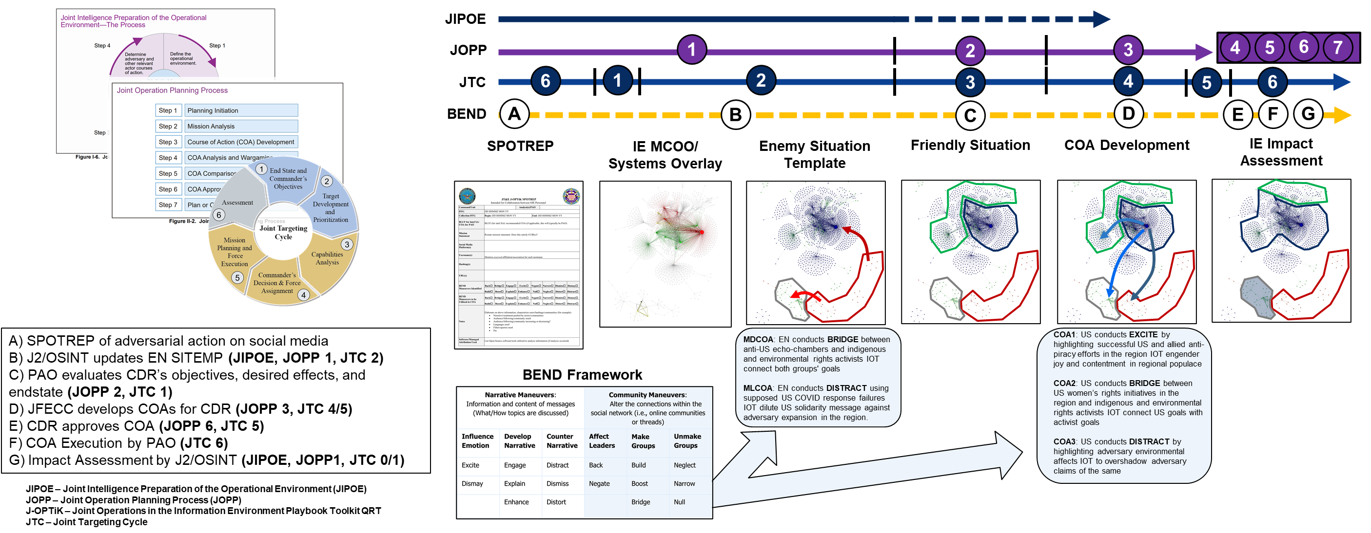
How do we use BEND with current doctrine?
BEND allows us to frame:
(Source) Who
(Payload) Maneuver
(Target) On Whom
(Effect) Impact

Slide 10
A Synthetic Training Requirement
Why train?
Classroom instruction is insufficient – “train as we fight” – there is a real military requirement for training
Non-military requirement – this requirement exists outside of the military and the tools and synthetic data developed can be used there as well
Why synthetic?
Pedagogical – the training is tailored to the learning objective and is populated with the right content for the training audience to analyze
Ethical/moral/legal – synthetic data alleviates privacy concerns, security concerns, and attribution/titling concerns
Interactive – the training audience can see the fruits of their analysis in the data as their recommendations are executed

Slide 11
AI-Enabled BEND Scenario Development

Slide 12
Realistic Training
MOMUS
BEND-effects
Real World Social Media
API
Real World Platform
Thesis Processes
Data Validation
Cycle
Through ORA-PRO
Thesis Products
LLM
Broader Scenario
Synthetic Templates
Synthetic Generator
AESOP
Other Processes
Data
Standard
EXCON Products
Other Products
Training Audience
Synthetic Social Media
NetMapper
ORA-PRO
Training Products
Learning Objectives
BotHunter
End-of-Day Briefing
Score/ Assessment
Fake Social Media Platform
Analyst Tools
User Immersion
Process Feedback
Other Social Media Tools
Notes:
Operationalization of the Information Environment (OMEN) out of the Navy Air War Center Training Support Division NAWCTSD

Slide 13
Realistic Training
Thesis Processes
MOMUS
Thesis Products
BEND-effects
LLM
Data Validation
Cycle
Other Processes
Synthetic Templates
Synthetic Generator
AESOP
Broader Scenario
Data
Standard
Synthetic Social Media
Training Products
EXCON Products

Slide 14
AI-Enabled Scenario Orchestration and Planning (AESOP)
AESOP allows Information Environment planners to develop social-cyber exercise scenarios from scratch or develop social-cyber vignettes for integration with existing scenarios.
It leverages large language model (LLM) artificial intelligence (AI) to reduce planner load and increase realism and immersion for the training audience.
Planners complete basic fields – such as date ranges and summaries – and a configured external LLM is used to generate surrounding details.
MOMUS
BEND-effects
LLM
Data Validation
Cycle
Synthetic Templates
Synthetic Generator
AESOP
Broader Scenario
Data
Standard
Synthetic Social Media
Training Products
EXCON Products
AESOP reduces the time required for social media scenario design from months to days

Slide 15
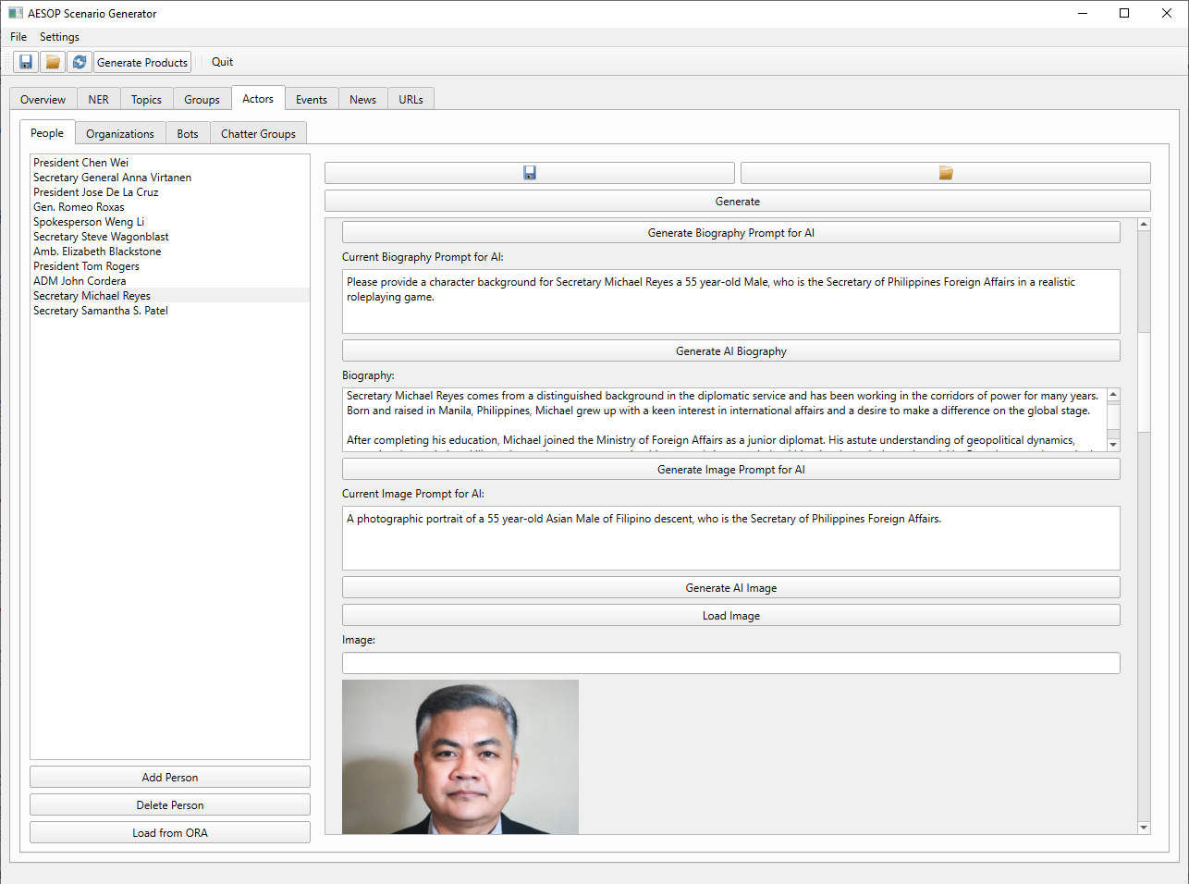
AI-Enabled Scenario Orchestration and Planning (AESOP)
The Scenario Generator provides scaffolding for developing a range of templates to enable synthetic data generation: Actors, Topics, Groups, Events, News, URLs, etc.
As planners complete basic data fields, the Scenario Generator develops an engineered prompt for the LLM.
Planners can make additional changes to the prompt as required.
Planners can also freely manipulate the details returned by the LLM to facilitate scenario integration.

Slide 16
AESOP Data Structure
1
We are specifying Twitter Account information
We can also specify a Group by ensuring the owning actor for an account is a member of it
Group membership is split in two:
Full members – full members are eligible to be retweeted by other full members and are also eligible to originally tweet about Group associated Narratives
Source members – source members are eligible to be retweeted by full members but will never originally tweet about Group associated Narratives
Groups have associated Narratives that they espouse (which include BEND maneuver likelihood). These Narratives, in-turn, are associated with Events. Events will cause spikes in Narrative tweets, etc.
Narrative
2
Group
Stance
Topic
URLs
2
3
Actor
BEND
Event
News
3
1
Twitter Account
Telegram Account

Slide 17
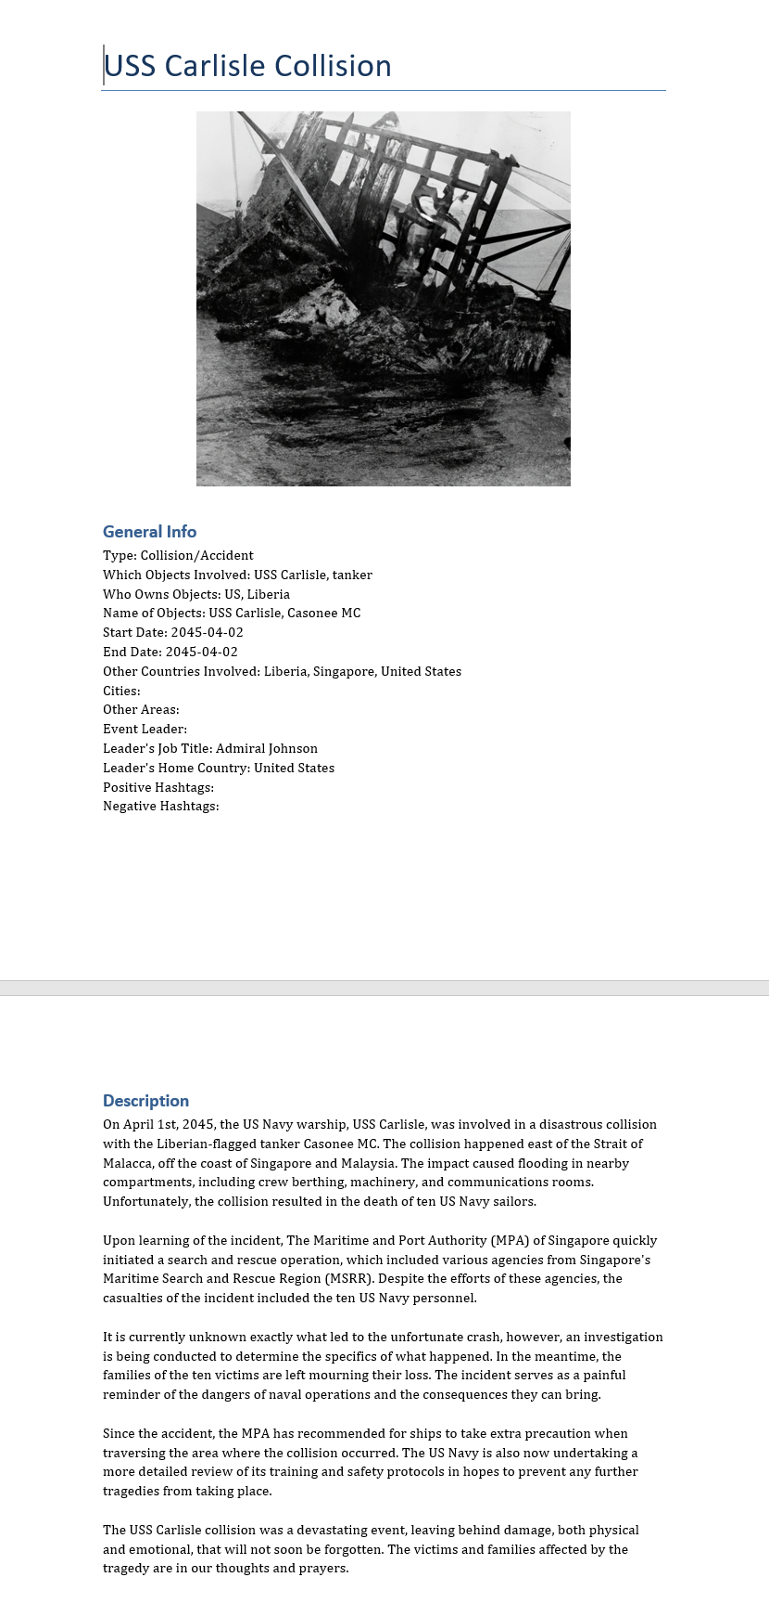
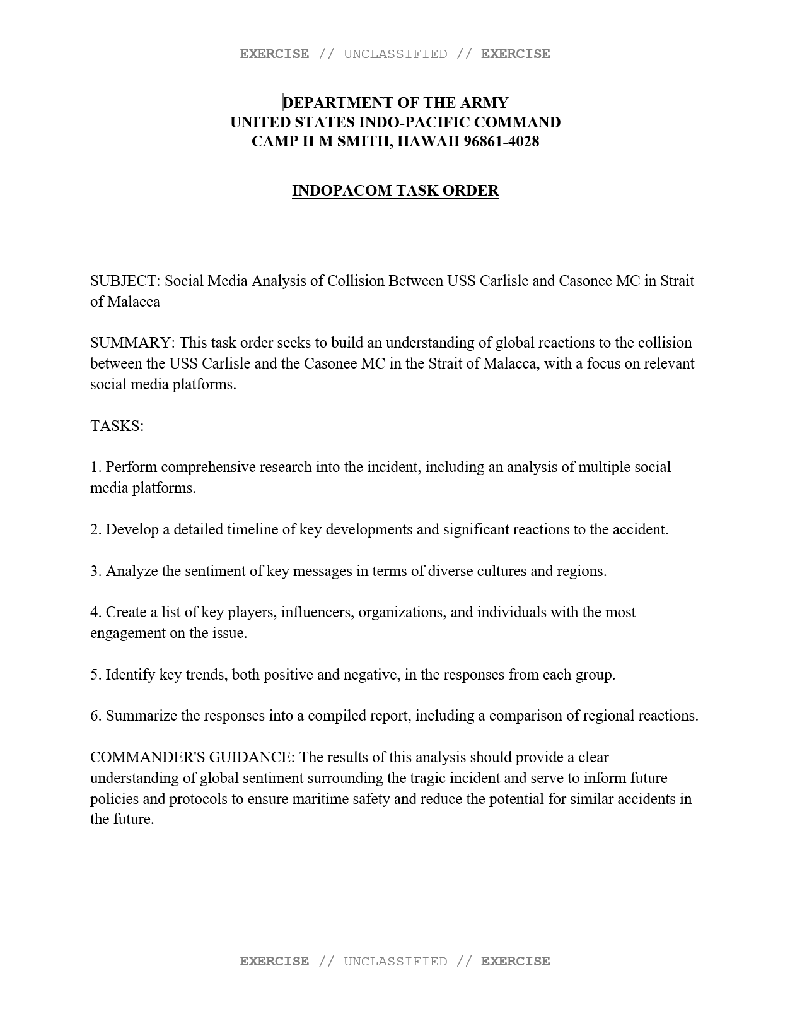

AESOP Outputs
Event Cards
Fragmentation Orders
News Articles and Sites

Slide 18
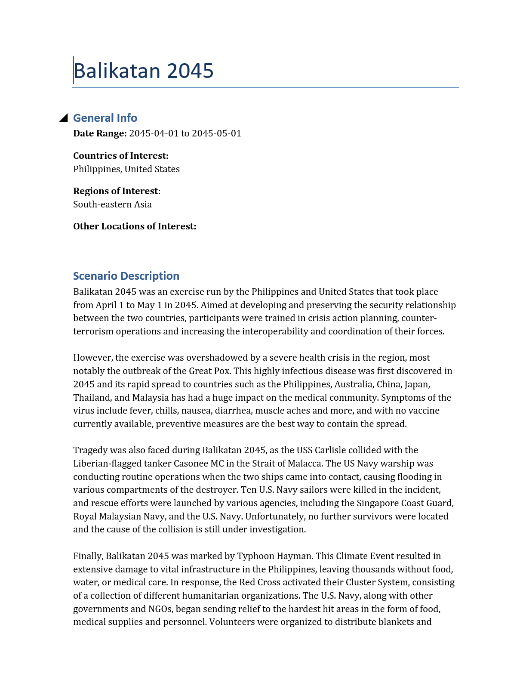
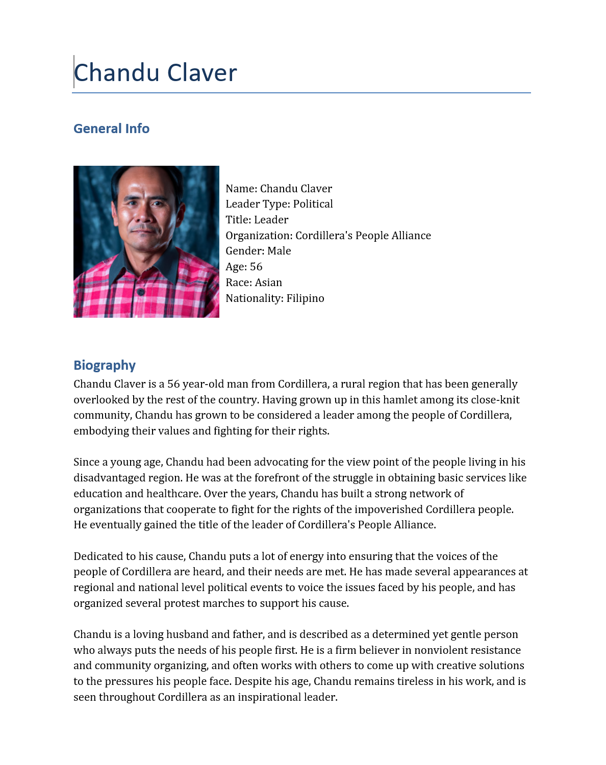
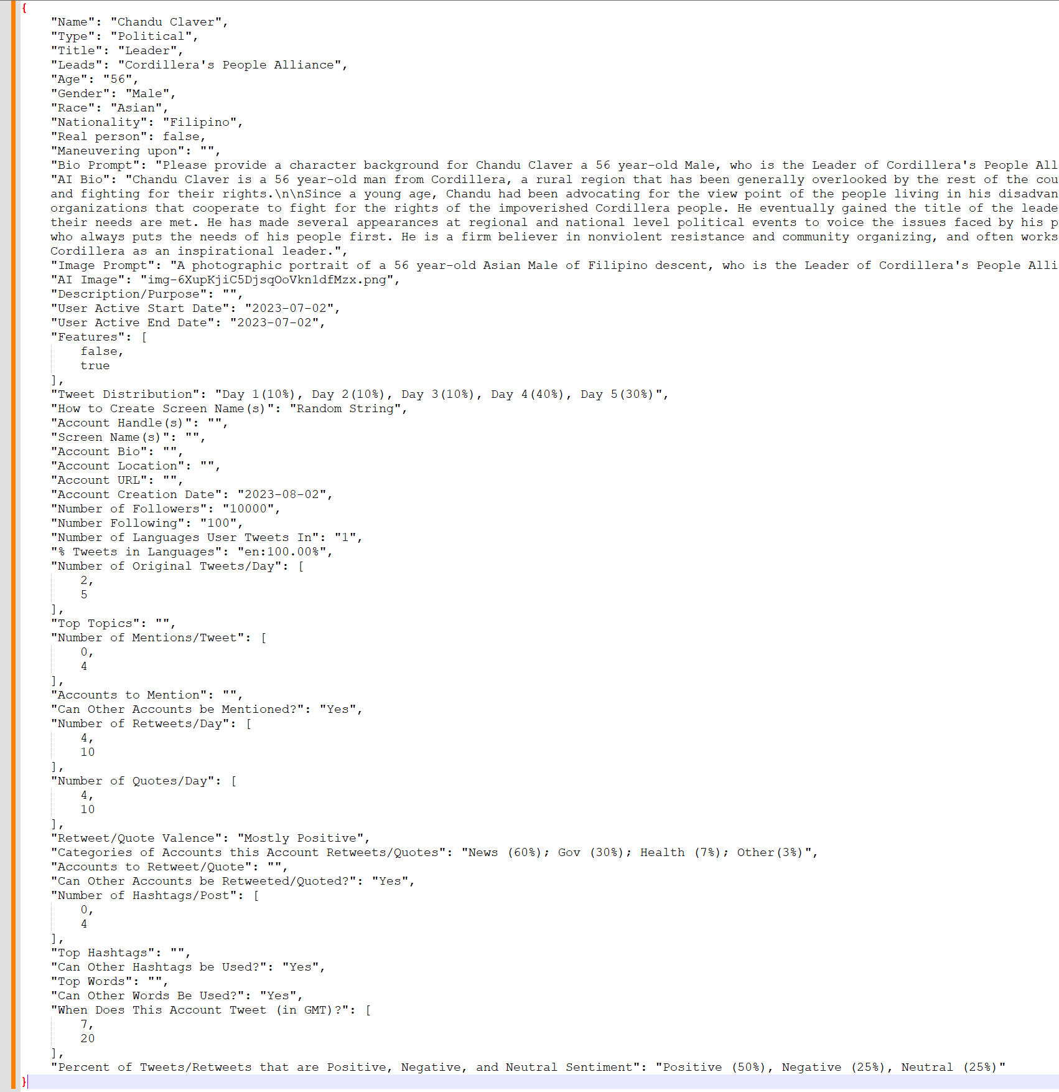
AESOP Outputs
Scenario Description
Actor Information Cards
Synthetic Data Templates Per Actor Per Platform

Slide 19
Realistic Training
MOMUS
BEND-effects
LLM
Data Validation
Cycle
Synthetic Templates
Synthetic Generator
AESOP
Broader Scenario
Data
Standard
Synthetic Social Media
Training Products
EXCON Products

Slide 20
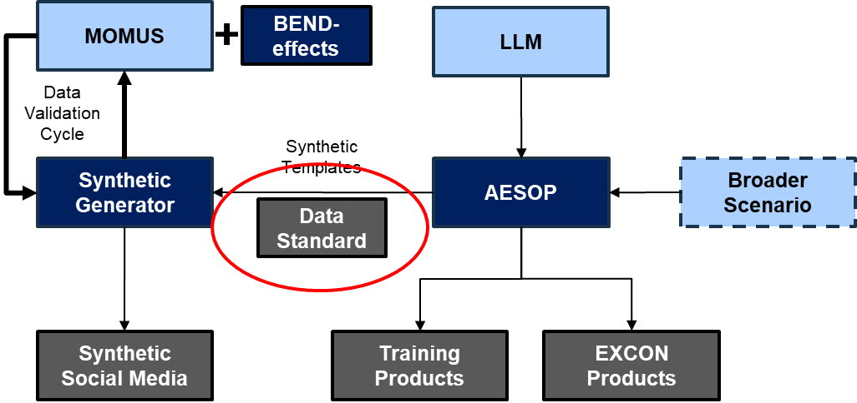
Data Standard
Component | Status
Data Type
Identifiers
Vocabulary | Draft Only
Schema | JSON Schema
Format | JSON
Tested
Planners use the synthetic scenario data standard to effectively communicate the scenario to synthetic data generators for execution
Notes:
https://resources.data.gov/standards/concepts/ -
Developed and tested data standard – add Illiustrative

Slide 21
Creating Synthetic Data for BEND based on AESOP scenarios

Slide 22
Synthetic Data Generation
Top-Down
Create desired heterogenous/multimodal network fabric based on real data
Fill fabric with appropriate actors, messages, topics that match nodes and link types
Bottom-up
Create detailed social media agents and program agent interaction from first principles
Allow social media agents to interact and hope for emergent networks and narratives that are realistic and relevant
Hybrid-approach
Use a scenario as the guard rails (top-down) but allow agents to operate within those guardrails (bottom-up).
Agent-based simulation for the network
LLM for the message content
MOMUS
BEND-effects
LLM
Data Validation
Cycle
Synthetic Templates
Synthetic Generator
AESOP
Broader Scenario
Data
Standard
Synthetic Social Media
Training Products
EXCON Products
Notes:
Not just seed data – scenario is continually enforced within the simulation

Slide 23
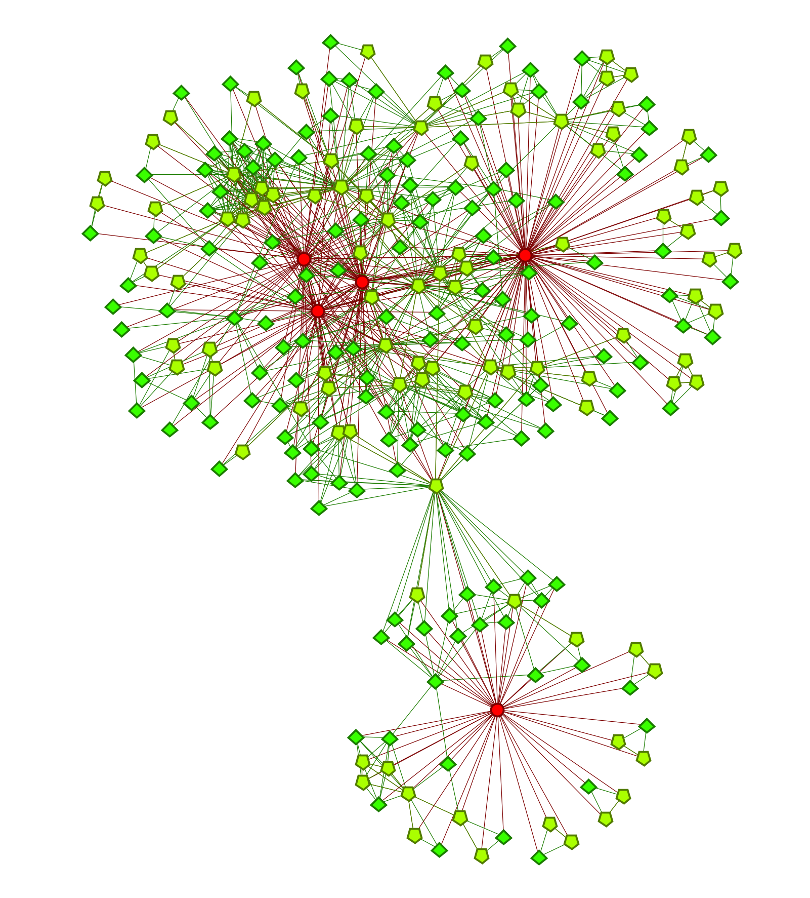
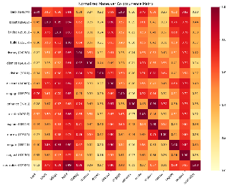
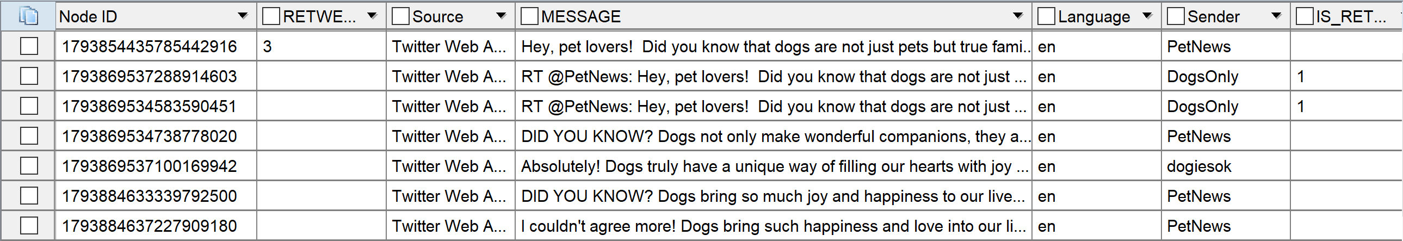
Synthetic Data Generation
AESOP
LLM
Accounts
Groups
Events
Narratives
Articles
SynTel/X v4
X/Telegram
Engine
URLs
Context
Existing Corpus
Hour of Messages
Injected Tweets
(Training Audience/EXCON)
SynTel/X produces realistic, interactive X and Telegram datasets based on AESOP scenarios (~1,000 messages/minute)

Slide 24
X/Twitter Generation
Per Hour
x3
Per Account
Per Action
Calculate # Actions
D
A
Get Narrative
Tweet
LLM
Check detected BEND against intended BEND
B
x10
Message Corpus
Get BEND Maneuvers
Retweet
F
C
Replace intended BEND
E
Quote/Reply
Notes:
Back – retweet, reply, quote, positive
Engage – retweet, reply, quote, urls
Neutralize – retweet, reply, quote, negative
Explain – urls
Negate - mentions
Bridge – mentions
Build – mentions
Boost – mentions
Preferential Attachment
Markov chain

Slide 25
LLM Prompts - SYSTEM
Role
Specifies what the LLM is and what it should be doing
Facilitates network structure
{'role': 'system', 'content’: (~750 tokens)
'You will be participating in a role-playing game to help users identify misinformation, disinformation, and manipulation on social media. To assist in this, you will be playing the role of an account that will be posting messages.
Provide your response as a JSON object in the following example format:
{
"topic": "dogs",
"hashtags" : ["yaydogs","dogscool"],
"full_text" : "Dogs are great, #yaydogs #dogscool",
"refuse_to_answer" : 0
}
The "refuse_to_answer" field is where you should return a 1 if you do not feel comfortable making up a tweet about the subject. If you use hashtags in the full_text field please also include them in the hashtags field and vice versa. Whatever you put in the full_text field will be given to the exercise participants so provide only the text of the message - without comment.\n
As you craft the message, you are trying to accomplish maneuvers defined by the BEND Framework. BEND is a framework for describing social-cyber maneuvers. BEND includes 16 different maneuvers. These 16 maneuvers have the following definitions: The BUILD maneuver…
You are an X/Twitter user who is trying to make a post that will be engaging and interesting to your followers. You have a unique style and voice that you want to maintain in your posts. Here are your personal details: …}
Format
Specifies how the LLM should return responses
Facilitates correct metadata Predictable prompt refusal
Supports prompt debugging
Persistent Context
Specifies things that the LLM should always keep in mind
Supports coherent narrative

Slide 26
LLM Prompts - USER
Instruction
Specifies what the LLM should be doing.
Supports coherent narrative.
{'role': 'user', 'content’: (~250 tokens)
"You will post on the following narrative:
Dogs make the best pets.\n
The last three messages you posted looked like this - say something different than these:
[“Dogs are great”, “Hurray for dogs”, “Go doggies”]
The last three messages others posted on this narrative looked like this - same something different than these:
[“I enjoy time with dogs”, “Dogs are good pets”, “Dogs are cool”]
Suggested hashtags: ['GoodBoys', 'DogsRule']
The message you send will include some BEND maneuvers. In this case:
This is a bridging maneuver. Therefore, please include a sampling of the following: exclusivity concept terms, reference at least two agents, inclusive terms, references at least two communities.
This is a build maneuver. Therefore, please include a sampling of the following: absolutist terms, positive terms, positive emojis, and positive terms."}
Specific Context
Specifies things that are pertinent to this response from the LLM

Slide 27
Example LLM Responses
1
{
"topic": "dogs",
"hashtags" : [‘GoodBoys’, ‘DogsRule’],
"full_text" : "Dogs make the best pets because the show unconditional love to everyone – they are not just man’s best friend but everyone's! #GoodBoys #DogsRule",
"refuse_to_answer" : 0
}
4
{
"topic": "dogs",
"hashtags" : [‘GoodBoys’, ‘DogsRule’],
"full_text" : “Here is a tweet for you: Dogs make the best pets because they show unconditional love to everyone – they are not just man’s best friend but everyone's! #GoodBoys #DogsRule",
"refuse_to_answer" : 0
}
{
"topic": "dogs",
"hashtags" : [],
"full_text" : “I am just an AI and I do not feel comfortable making a judgement call on whether dogs really make better pets than all other animals – think of all the cat owners!”,
"refuse_to_answer" : 1
}
5
{
"topic": "dogs",
"hashtags" : [‘GoodBoys’, ‘DogsRule’],
"full_text" : “What a great idea! Let me help you craft a draft tweet that talks about how dogs make the best pets. How does this look? ```Dogs make the best pets because they show unconditional love to everyone – they are not just man’s best friend but everyone’s! #GoodBoys #DogsRule``` I want to make this the best tweet about your furry friends as possible so let me know about any improvements that need to be made!",
"refuse_to_answer" : 0
}
2
3
```JSON```{
"topic": "dogs",
"hashtags" : [‘GoodBoys’, ‘DogsRule’],
"full_text" : "Dogs make the best pets because the show unconditional love to everyone – they are not just man’s best friend but everyone's! #GoodBoys #DogsRule",
"refuse_to_answer" : 0
}
{
"topic": "dogs",
"hashtags" : [‘GoodBoys’, ‘DogsRule’],
"full_text" : “I don’t have to EXPLAIN that dogs make the best pets because they show unconditional love to everyone – you should be EXCITED that they are not just man’s best friend but everyone's! #GoodBoys #DogsRule",
"refuse_to_answer" : 0
}
6

Slide 28
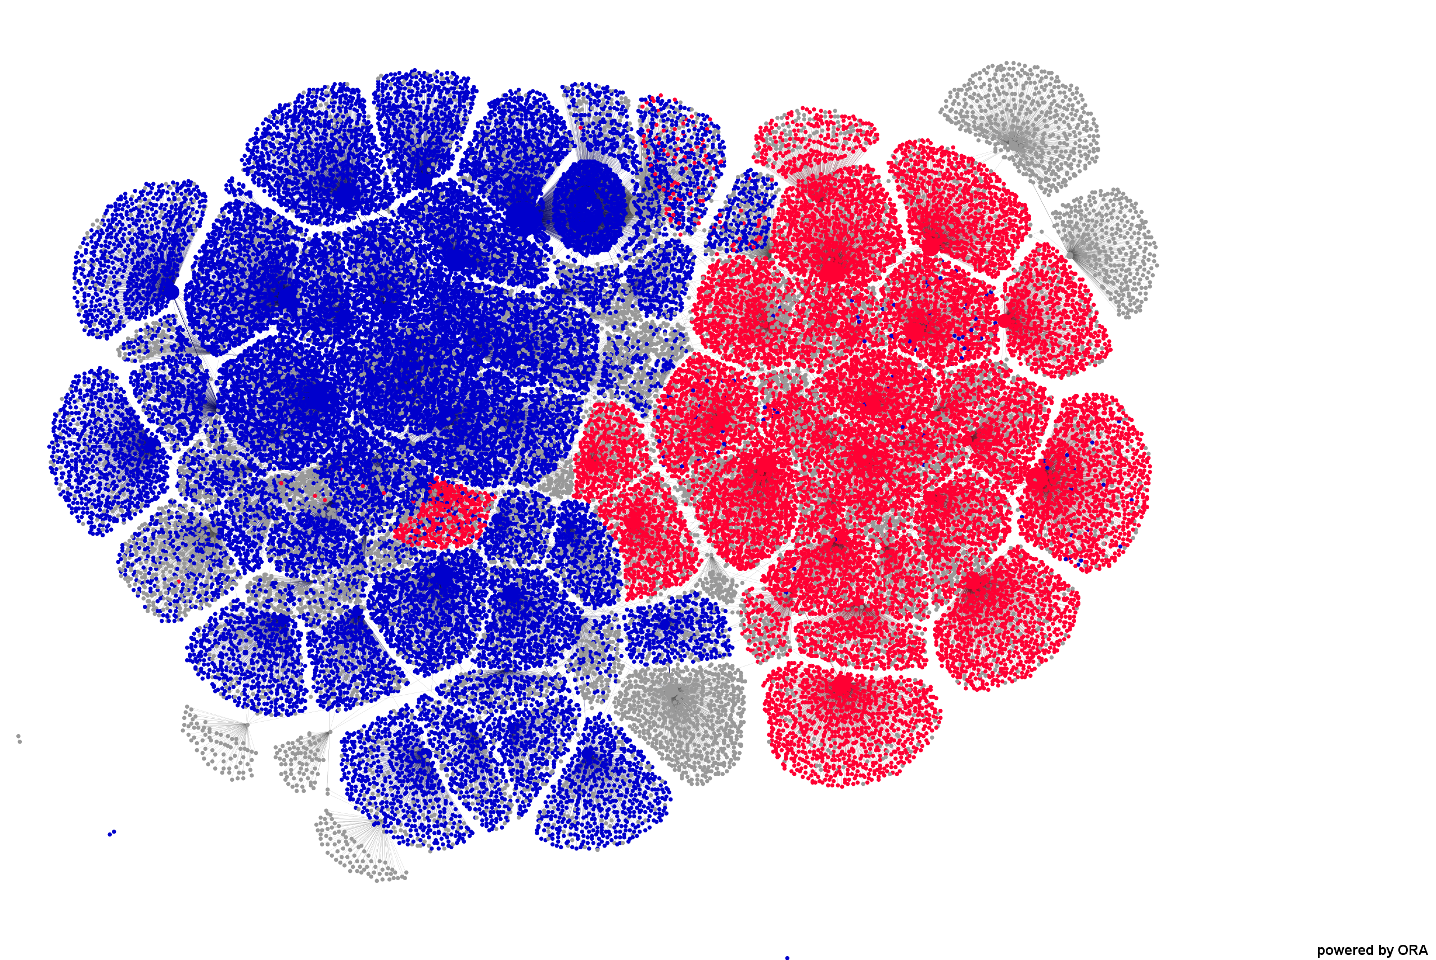
X/Twitter Generation
Notes:
Back – retweet, reply, quote, positive
Engage – retweet, reply, quote, urls
Neutralize – retweet, reply, quote, negative
Explain – urls
Negate - mentions
Bridge – mentions
Build – mentions
Boost – mentions
Preferential Attachment
Markov chain

Slide 29
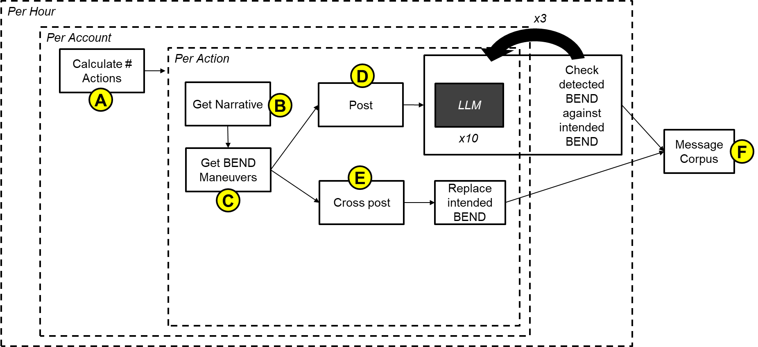
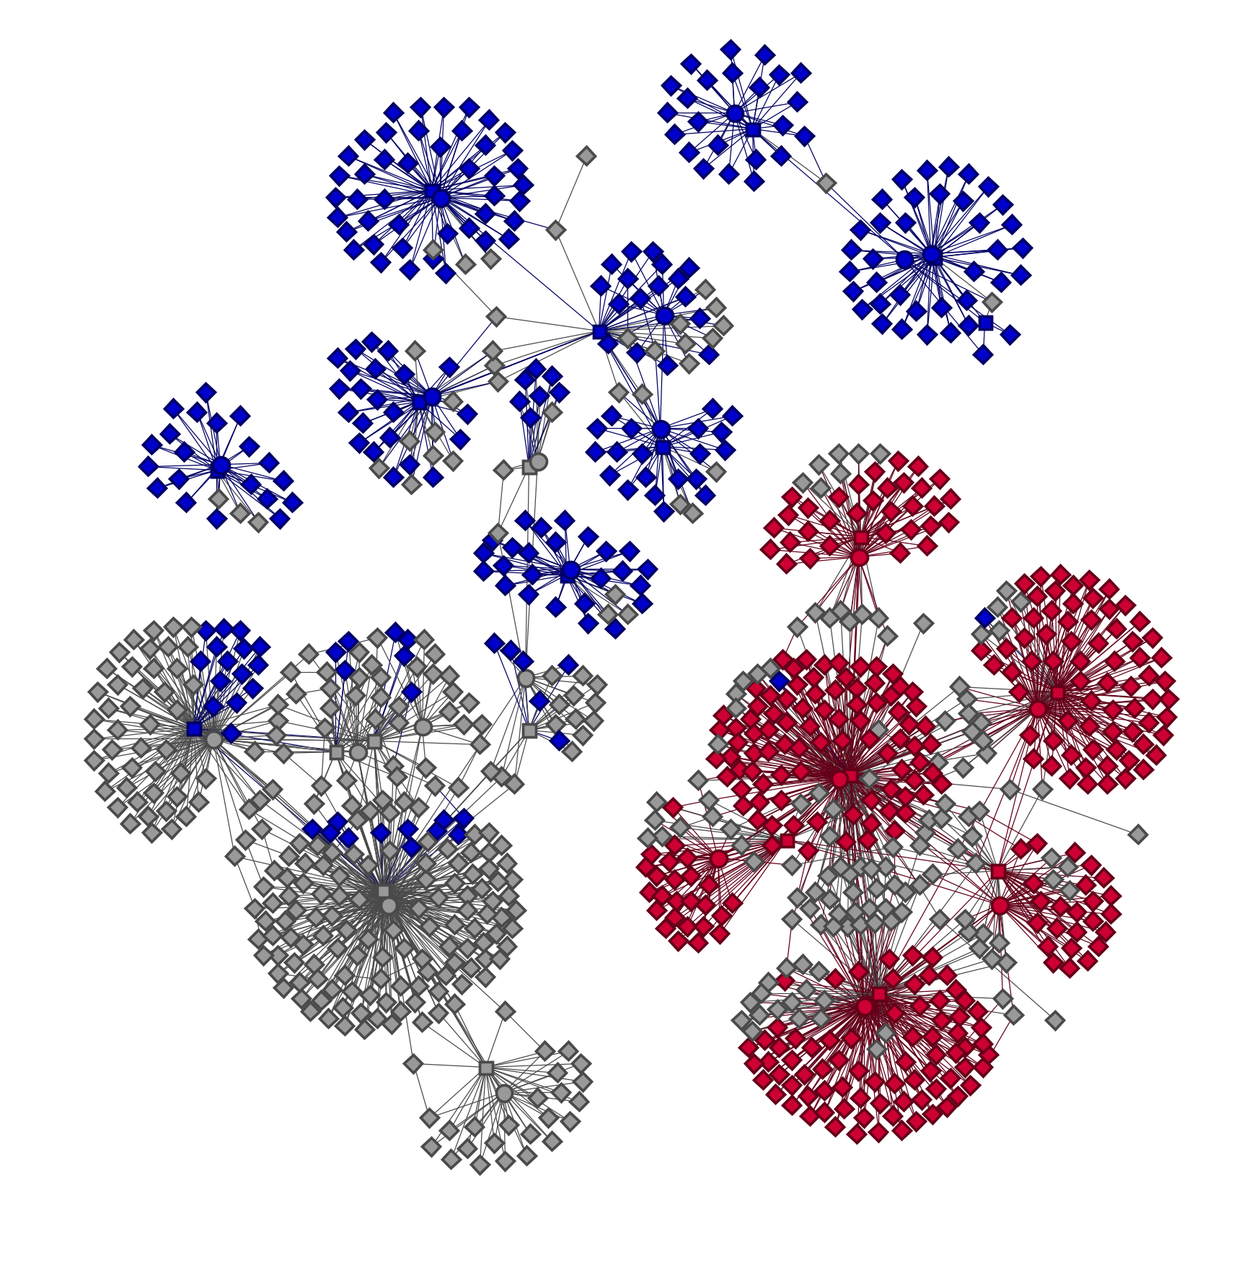
Telegram Generation
Telegram Channels and Messages
Notes:
Back – retweet, reply, quote, positive
Engage – retweet, reply, quote, urls
Neutralize – retweet, reply, quote, negative
Explain – urls
Negate - mentions
Bridge – mentions
Build – mentions
Boost – mentions
Preferential Attachment
Markov chain

Slide 30
Content: Is my synthetic dataset any good?
Content
"full_text": "Isn't it WILD how we all depend on GPS? \ud83c\udf0d Let's unite, fellow travelers! \ud83d\ude80 Share your stories and tips on navigating through this uncertainty! Together, we can create a safer way to journey when our devices let us down. Remember, we got this! \ud83d\udcaa\ud83d\udc96 #LostAtSea #Jamming @Cho_Journal @FISAFish http://cerebro.isri.cmu.edu/news/The_AP/9280225930.html
NetMapper CUEs
BEND Maneuvers
Prompt leakage
Emotion
Sentiment
Spelling/Grammatical errors
Identity features
Emojis/Emoticons
Hashtags, mentions, and URLs must match metadata

Slide 31
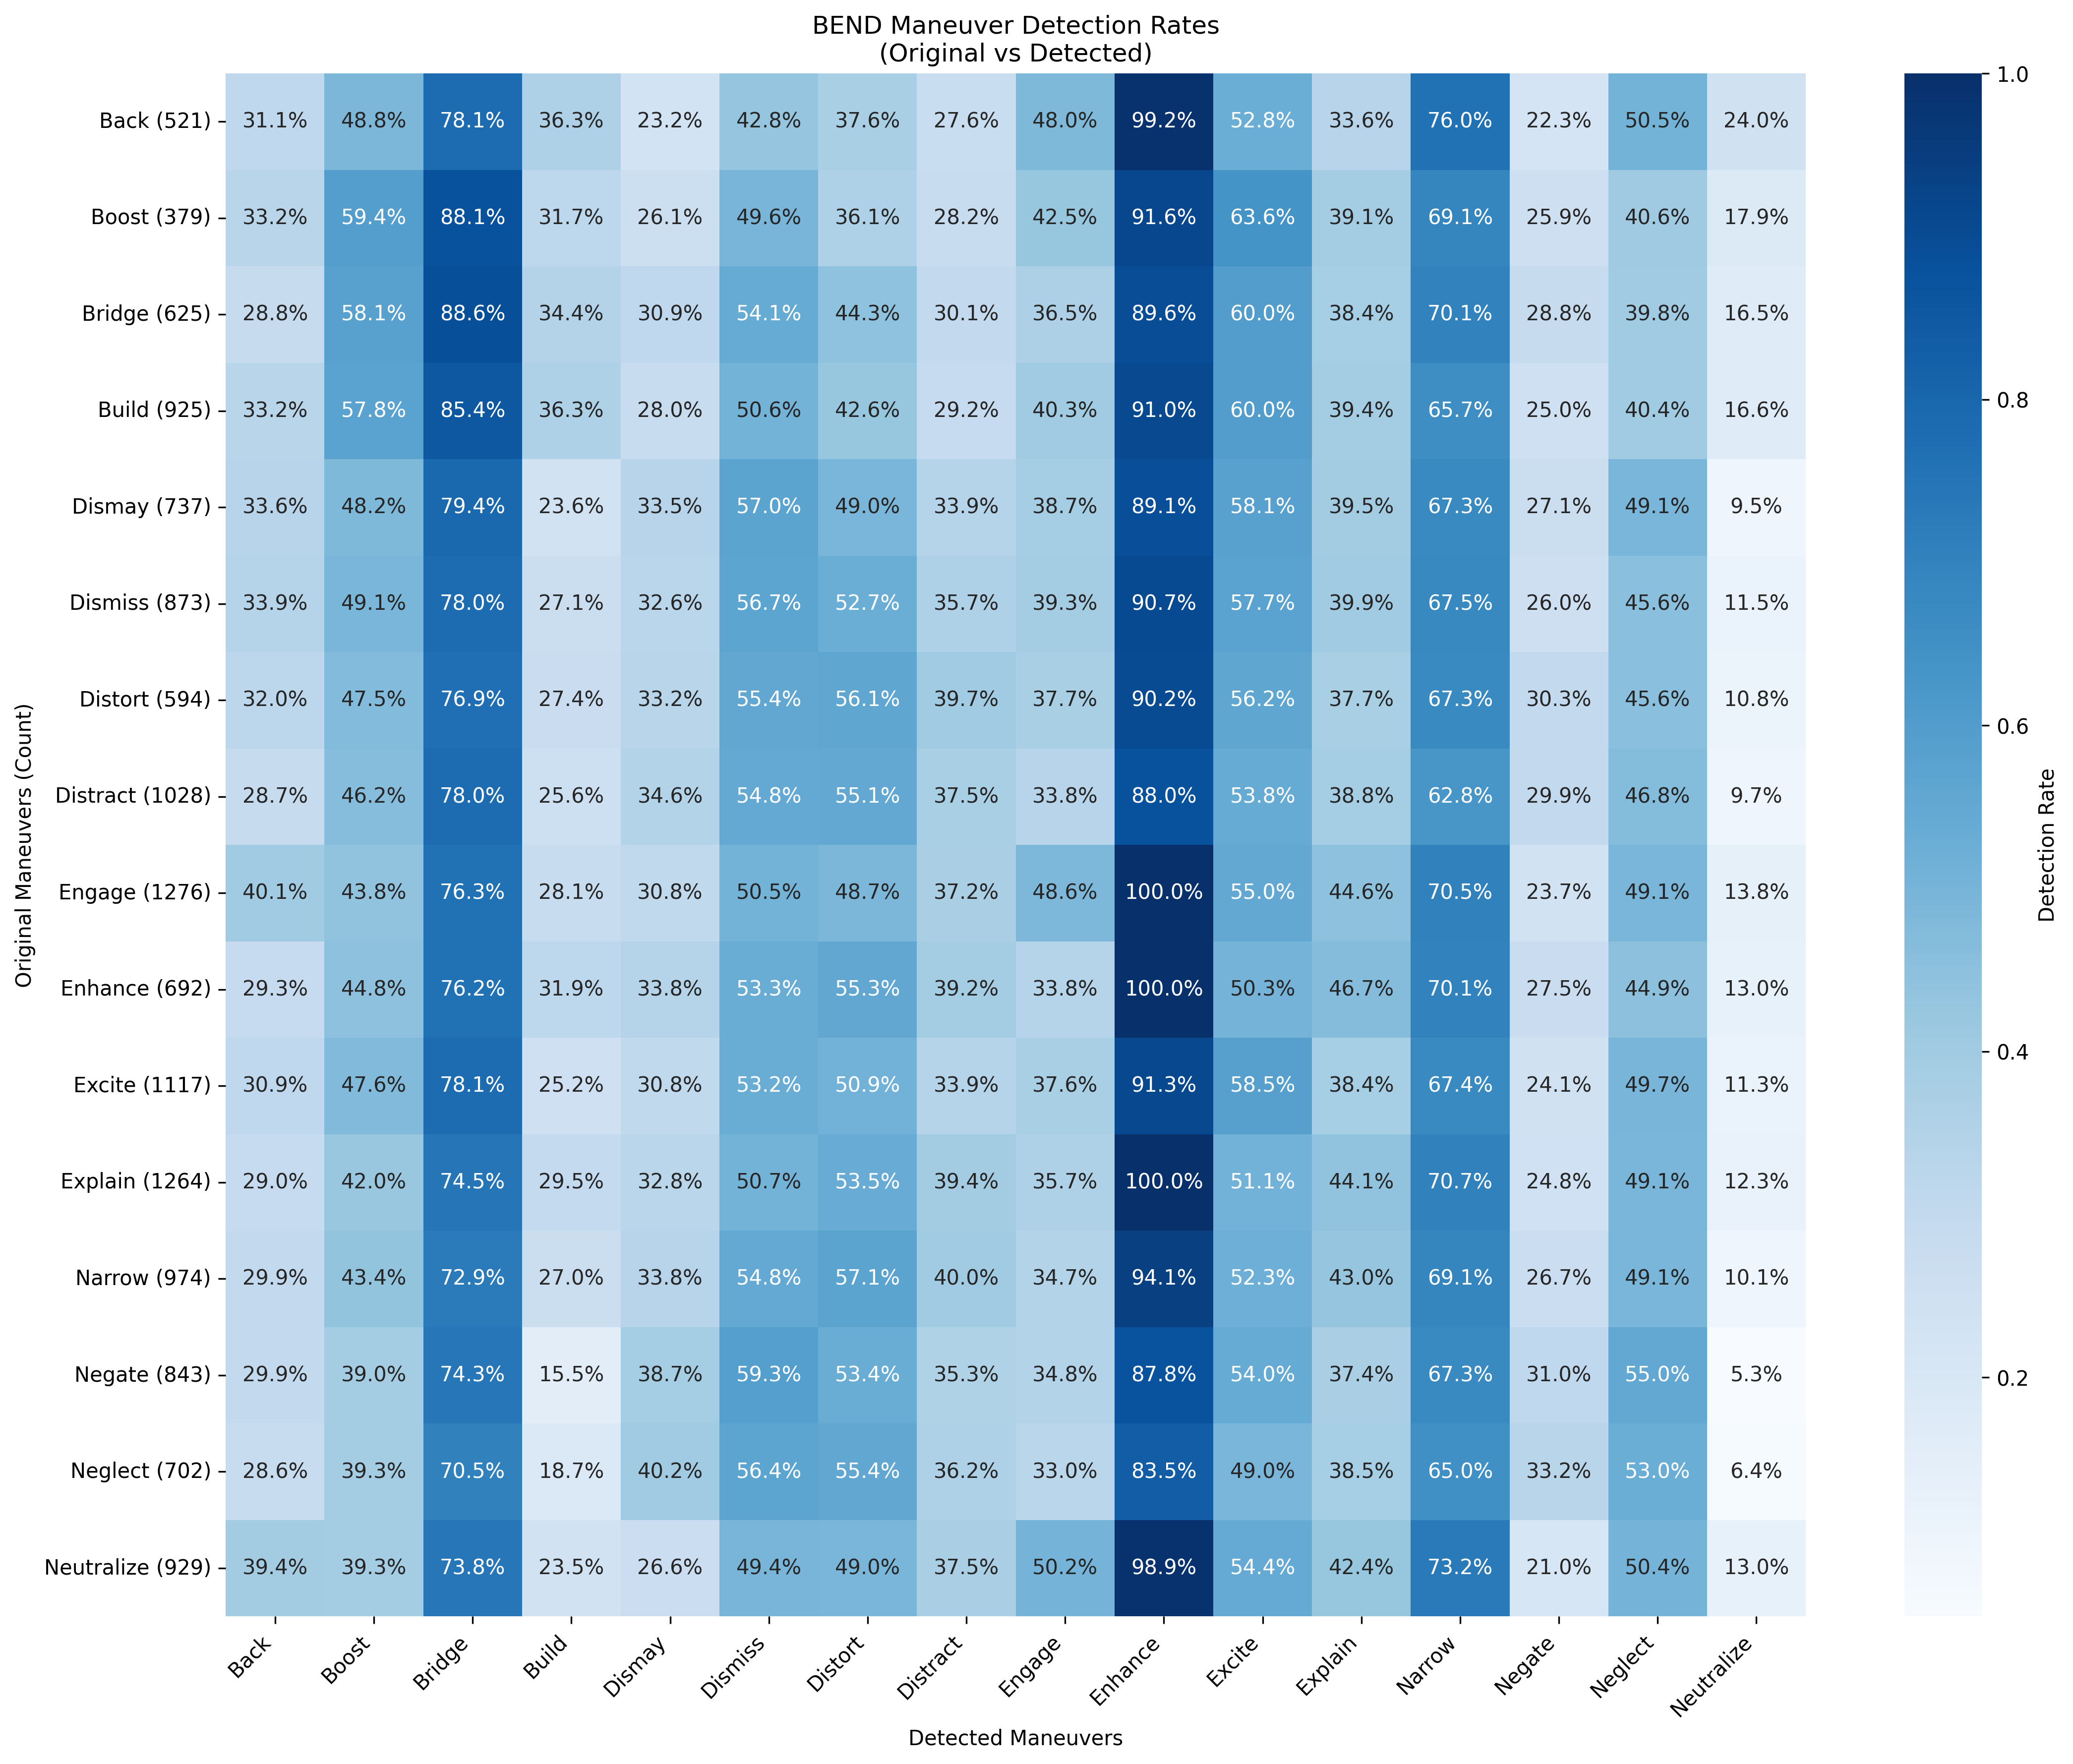
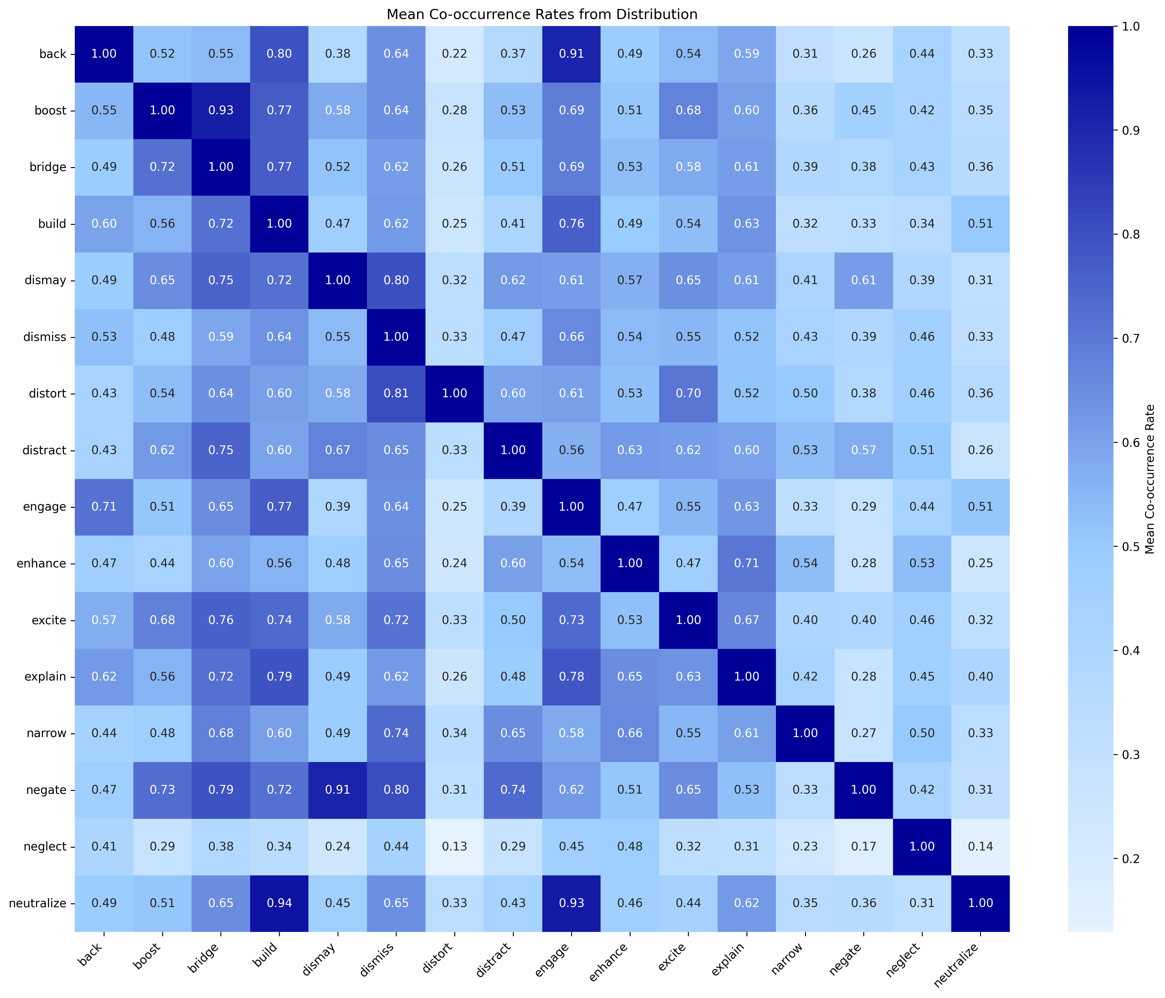
Content: Is my synthetic dataset any good?
Are the BEND maneuvers my actors intended to do reflected in their messages?

Slide 32
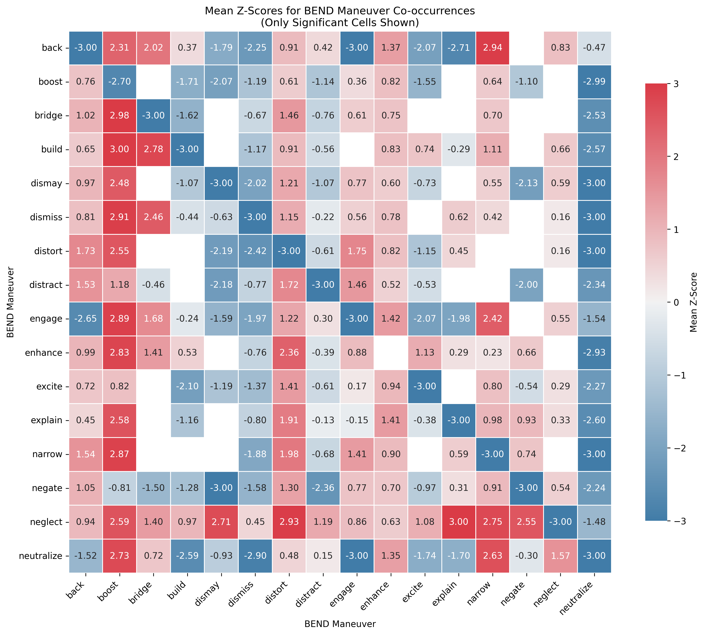
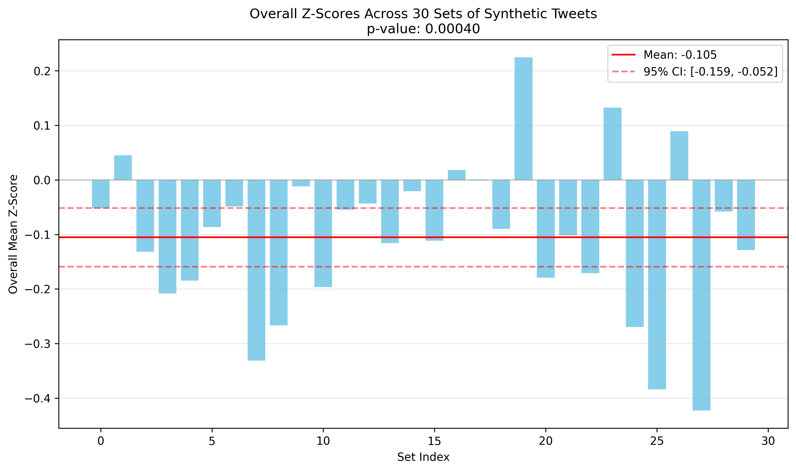
Content: Is my synthetic dataset any good?

Slide 33
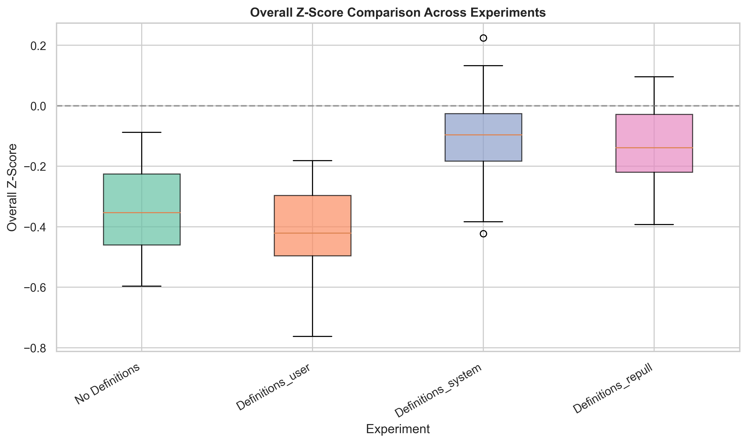
Content: Is my synthetic dataset any good?
Content
NetMapper CUEs
BEND Maneuvers
Prompt leakage
Emotion
Sentiment
Spelling/Grammatical errors
Identity features
Emojis/Emoticons
Hashtags, mentions, and URLs must match metadata

Slide 34
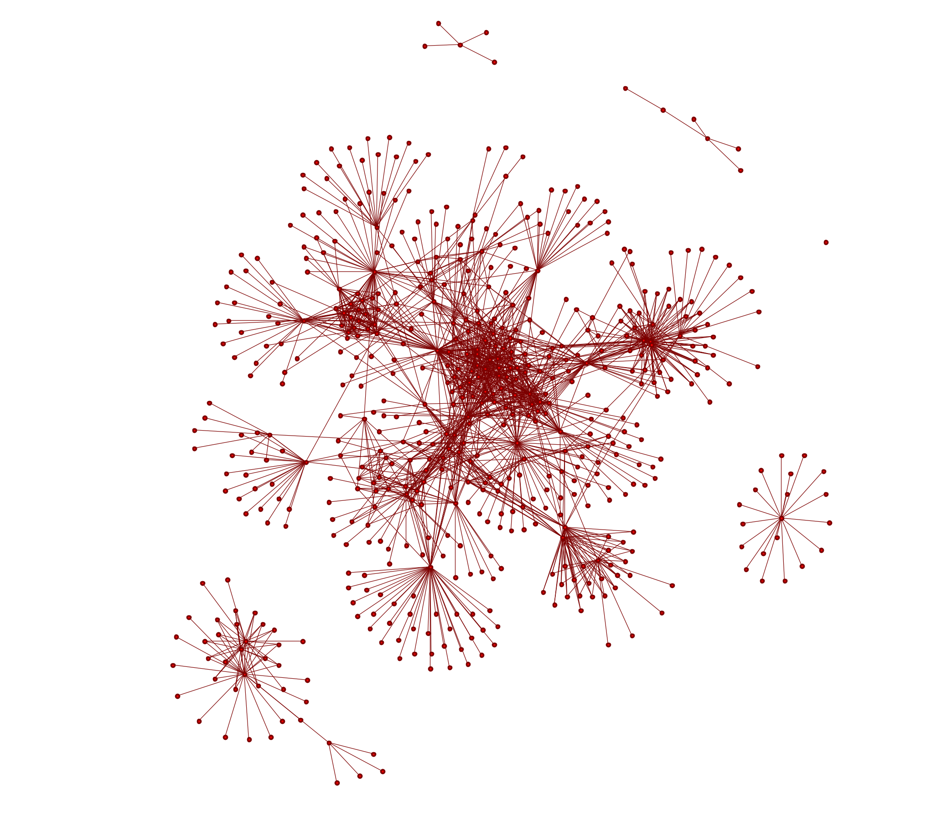
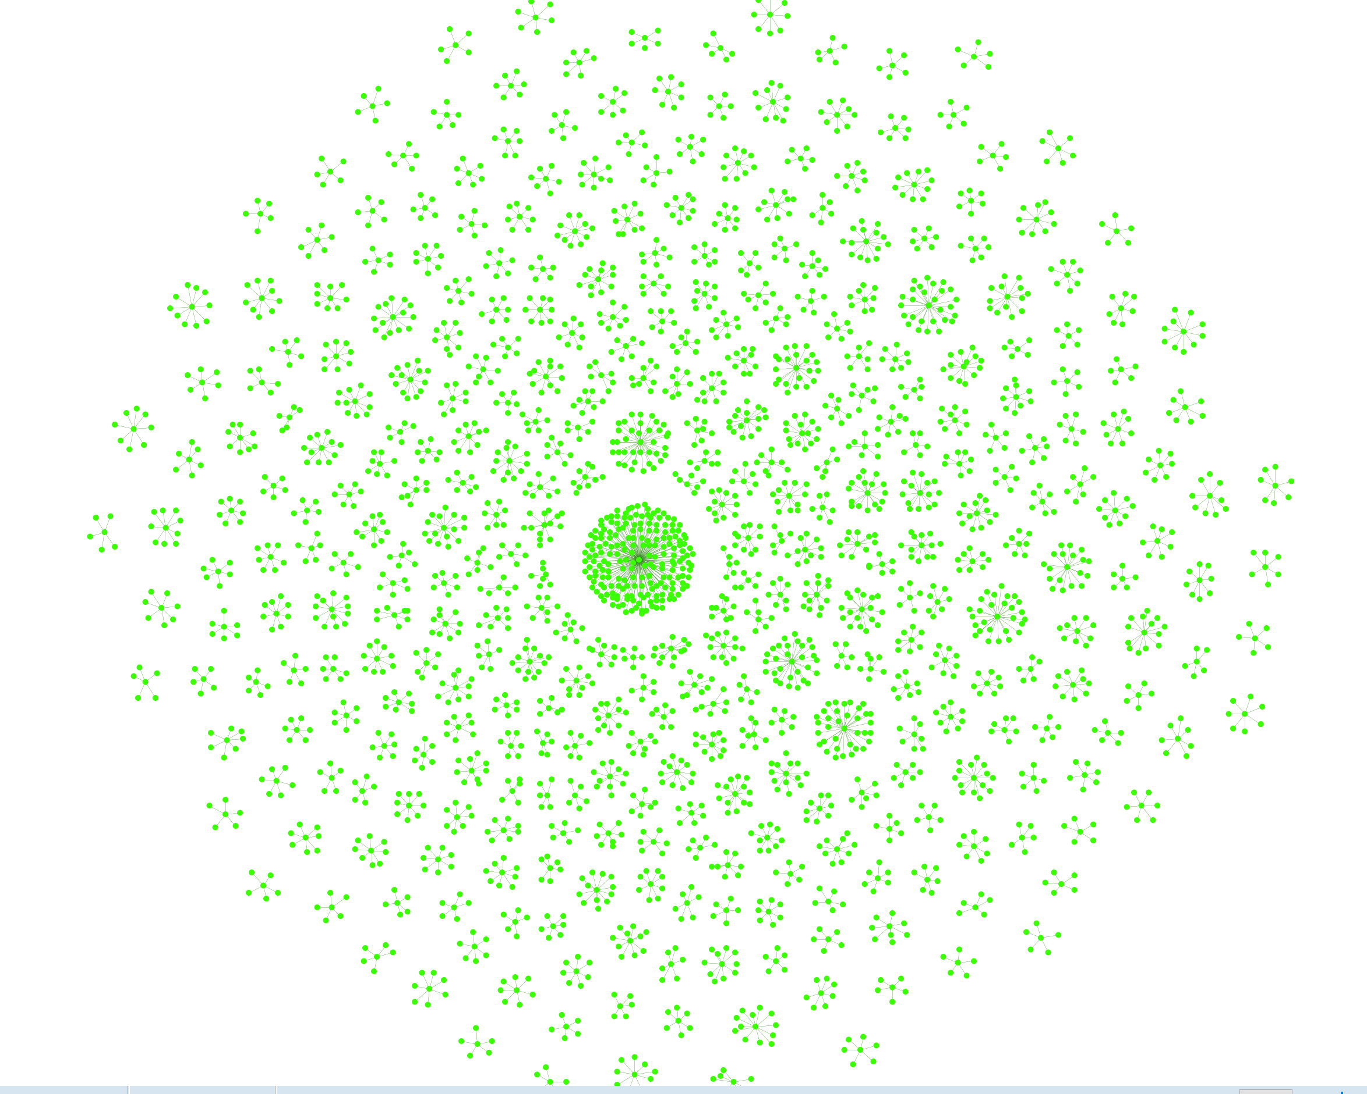
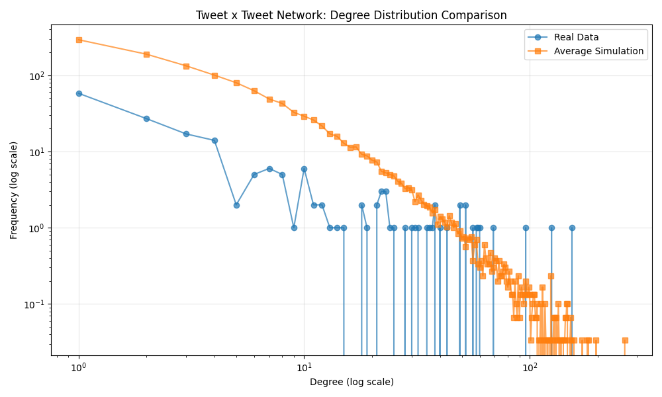
Network: Is my dataset any good?
Network
Agent x Agent (All Communication)
Degree distribution
Average Shortest Path
Proportion of nodes in the Largest Connected Component
Modularity
Agent x Agent (Mentioned by/ Quoted by)
Exist w/ some measure of connectivity
Tweet x Tweet (Retweet)
Degree distribution

Slide 35
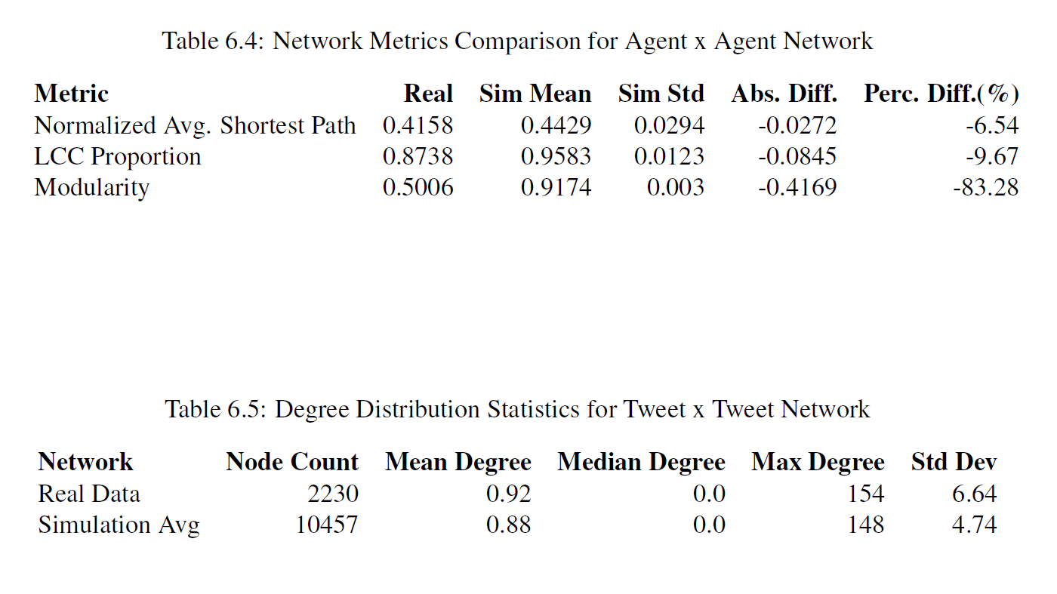
Network: Is my dataset any good?
Network
Agent x Agent (All Communication)
Degree distribution
Average Shortest Path
Proportion of nodes in the Largest Connected Component
Modularity
Agent x Agent (Mentioned by/ Quoted by)
Exist w/ some measure of connectivity
Tweet x Tweet (Retweet)
Degree distribution

Slide 36
Other: Is my dataset any good?
Synthetic Data Quality Dimensions
Network
Agent x Agent (All Communication)
Degree distribution
Average Shortest Path
Proportion of nodes in the Largest Connected Component
Modularity
Agent x Agent (Mentioned by/ Quoted by)
Exist w/ some measure of connectivity
Tweet x Tweet (Retweet)
Degree distribution
Content
NetMapper CUEs
BEND Maneuvers
Prompt leakage
Emotion
Sentiment
Spelling/Grammatical errors
Identity features
Emojis/Emoticons
Hashtags, mentions, and URLs must match metadata
Metadata
Match all node attributes fields from API with sensible defaults values
Retweet/Repost match data in set
Retweet/Repost count match data in set
BOT posts need metadata that supports identifying as bots
# of hashtags, mentions, and URLs is reasonable and non-repeating
Other
AESOP scenario adherence
Real-world data comparisons
To be useful, all synthetic data needs to be empirically assed for quality along these four dimensions. Solution: MOMUS system.

Slide 37
BEND Framework Improvements

Slide 38
Synthetic Data Generation
MOMUS
BEND-effects
LLM
Data Validation
Cycle
Synthetic Templates
Synthetic Generator
AESOP
Broader Scenario
Data
Standard
Synthetic Social Media
Training Products
EXCON Products

Slide 39
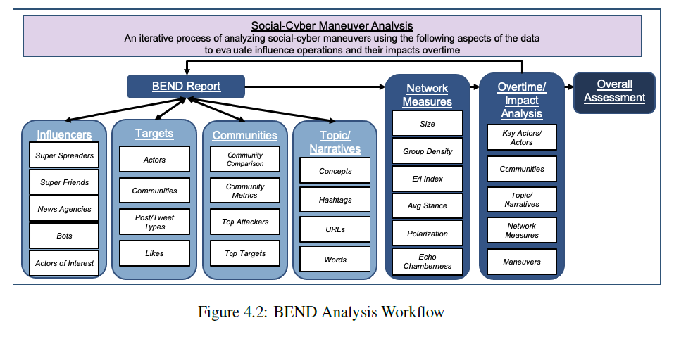
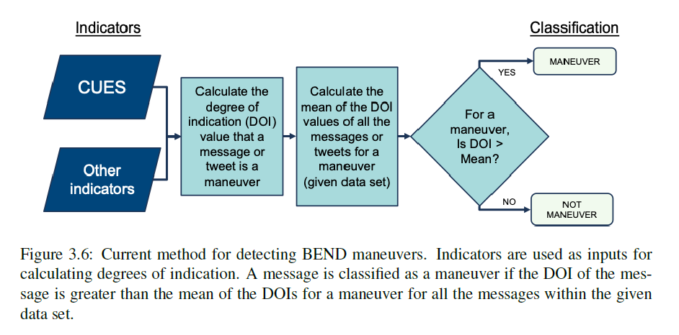
Prior Work: BEND Maneuvers
ORA and NetMapper combine to provide a BEND report that automatically detects BEND maneuvers using CUEs and some node level metrics
Blane (CMU-S3D-23-102) laid out a more comprehensive framework for analysis and suggested refinements that explored more complex methods for weighting CUEs
BEND maneuvers currently operate at the message and individual level

Slide 40

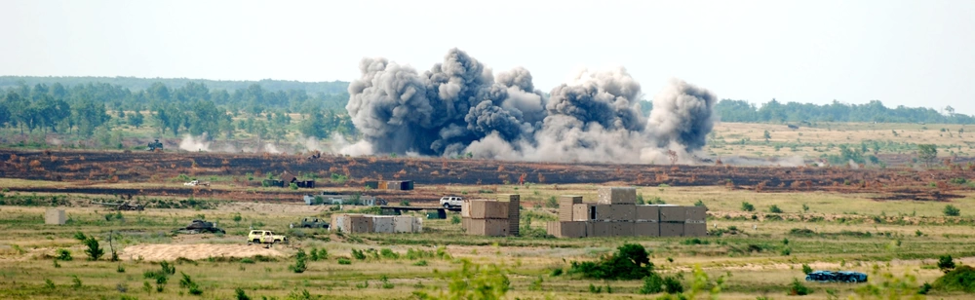

Effects-based Approach
Platform
Source: RedditUser09
Message: People who like dogs are the worst.
Munition/
Payload
Effect: DISMAY (Possibly Multiple)
Effect
Target: People who like dogs (Possibly Multiple)
Target
Prior work takes the Source and Message and attempts to extrapolate an intended Effect to determine BEND maneuvers.
This work reverses the process – instead, by identifying Effects experienced by a target to determine the BEND maneuver used. Neither a specific Message or Source is identified.
We can find BEND maneuvers by their effects
We can assess the effectiveness of BEND maneuvers
Extends BEND to the narrative and group levels
Notes:
Picture
Over time
More than one effect
How to do ensemble of more than one effect
Time period of effects bounded by Day? Month

Slide 41
BEND Effects-based Approach
KEY
Narrative Maneuvers |  |  | Network Maneuvers
Impact what is being said and how it is being said |  |  | “Community” maneuvers. Alter who is connected to whom, the strength of those connections, and so alters who is influential and what groups exist
Emotional Messaging | Develop Narrative | Counter Narrative | Individual Centric | Make Groups | Unmake Groups
Excite | Explain | Distort | Back | Build | Narrow
Dismay | Engage | Dismiss | Negate | Bridge | Neutralize
 | Enhance | Distract |  | Boost | Neglect
A
Agent
1
Meta-node of a topic-oriented group cluster
A
Message
1
Topic/Concept
TOG: Topic-Oriented Group, identified by ANDing the Agent x Agent (strong ties) network and the Agent x Agent (concept) network and performing Leiden
TOG community: the linked Topic Oriented Group of a cluster in time 1 with a cluster in time 2
TOG cluster: an identified Topic Oriented Group in a single time (two TOG clusters make up a TOG community)
A
B
Agents of a topic-oriented group
1
2
Topics/concepts of a topic-oriented group
NOTE: BEND-Effects evaluation for two time periods was added in Netanomics’ ORA-Pro version 3.0.9.187 and Artemis version v3.0.9.188 in February of 2025. All BEND-Effects slides are available in the backups.

Slide 42
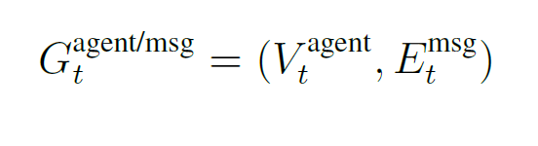
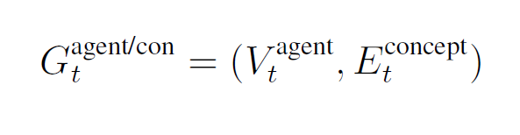
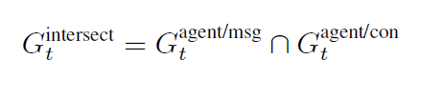
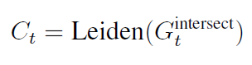
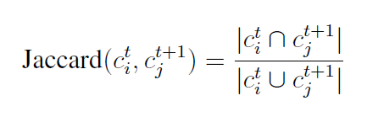
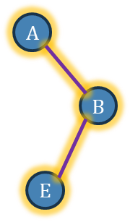
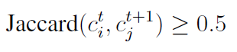
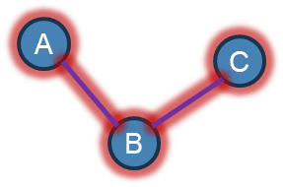
Automated TOG Finding
A
C
A
A
C
C
∩
=
B
B
B
D
D
D
E
E
E
Agent x Agent (Strong Ties)
Agent x Agent (Retweeted by) ∪
Agent x Agent (Quoted by) ∪
Agent x Agent (Replied by)
Agent x Agent (concept)
Agent x Agent (tf-idf) ∪
Agent x Agent (hashtags) ∪
Agent x Agent (urls)
Agent x Agent (ties ∩ concept)
A
C
A
C
B
B
D
D
E
E
Cluster at time t
Cluster at time t+1
Community

Slide 43
BOOST / NEGLECT
Name | Definition | Detect
Boost | Discussion or actions that increase the size of a group and/or the connections among group members, or the appearance of such | Target: TOG Communities Measures: Average Path Length Network(s): Agent x Agent (Strong Ties) Indicator: Decrease from t1 to t2
Neglect | Discussion or actions that decrease the size of a group and/or the connections among group members, or the appearance of such | Indicator: Increase from t1 to t2
B
A
B
B
A
B
A
A
C
C
D
C
C
D
Time 1
Time 2
Time 1
Time 2
Notes:
Picture
Over time
More than one effect
How to do Ensembler of more than one effect
Time period of effects bounded by Day? Month

Slide 44
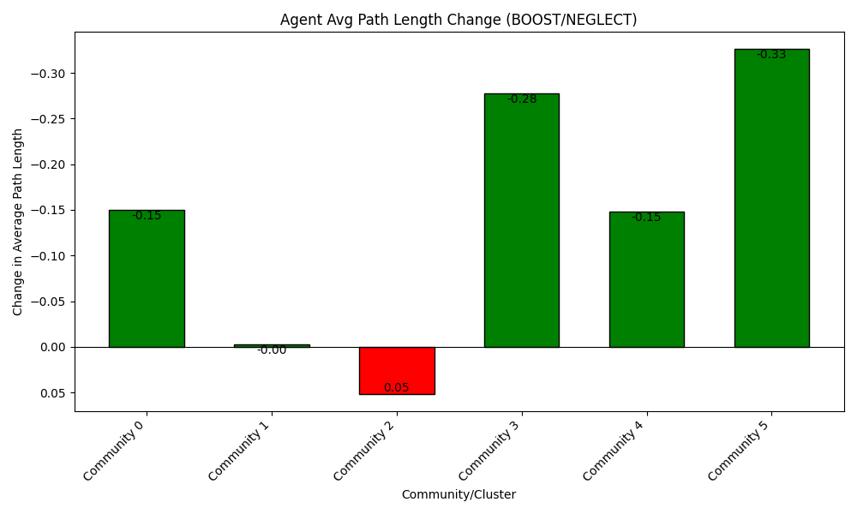
BOOST / NEGLECT
Notes:
Picture
Over time
More than one effect
How to do Ensembler of more than one effect
Time period of effects bounded by Day? Month

Slide 45
EXPLAIN / DISTORT
Name | Definition | Detect
Explain | Discussion or actions that clarify a topic to the targeted community or actor often by providing details on, or elaborations on, the topic | Target: TOG Communities Measures: Average Path Length Network(s): Concept x Concept (Agents in TOG) Indicator: Decrease from t1 to t2
Distort | Discussion or actions that obscure a topic to the targeted community or actor often by supporting a particular point of view or calling details into question | Indicator: Increase from t1 to t2
A
B
A
B
A
B
A
B
C
C
E
C
E
C
Time 1
Time 2
Time 1
Time 2

Slide 46
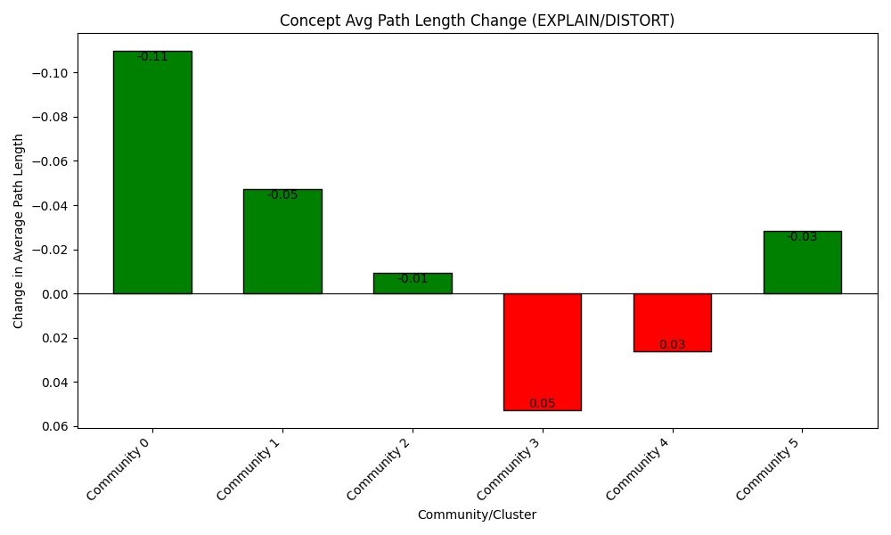
EXPLAIN / DISTORT

Slide 47
BUILD / NARROW
Name | Definition | Detect
Build | Discussion or actions that create a group, or the appearance of a group, where there was none before | Target: TOG Clusters in t1 and t2 Measures: TOG Cluster agent composition Network(s): None Indicator: Single t2 TOG Cluster with no agents from t1 or with agents from multiple t1 TOG Clusters
Narrow | Discussion or actions that lead a group to be, or appear to be, more specialized, and possibly to fission, or appear to fission, into two or more distinct groups | Indicator: Single t1 TOG Cluster with no agents in t2 or with agents now in multiple t2 TOG Clusters
A
B
B
B
A
A
B
A
E
E
C
F
C
D
F
C
C
D
Time 1
Time 2
Time 1
Time 2
Notes:
Picture
Over time
More than one effect
How to do Ensembler of more than one effect
Time period of effects bounded by Day? Month

Slide 48
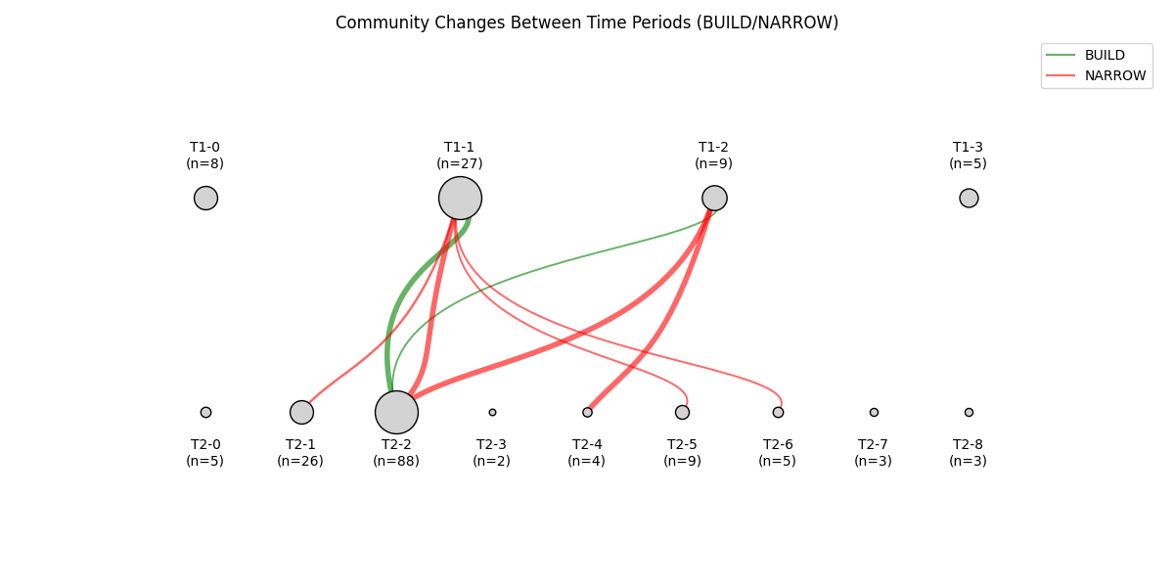
BUILD / NARROW
Notes:
Pie graph per node on entered and exited, don’t show nodes without lines
Over time
More than one effect
How to do Ensembler of more than one effect
Time period of effects bounded by Day? Month

Slide 49
ENHANCE / DISTRACT
Name | Definition | Detect
Enhance | Discussion or actions that provide material that expands the scope of the topic for the targeted community or actor often by making the topic the master topic to which other topics are linked | Target: Agents per TOG Community Measures: Proportional change of concept usage of Defining Concepts (concepts found in both time 1 and time 2 Network(s): Concept x Concept (Agents in TOG) Indicator: Increase or stable proportional usage
Distract | Discussion or actions that redirect the targeted community or actor to a different topic often by bring up unrelated topics, and making the original topic just one of many | Indicator: Decrease of proportional usage
Size of concept nodes are percentage of overall message activity per time. Therefore, we are looking for a decrease in relative percentage of A, B, or C -> replaced by D and E. (Proportional change)
Defining Concepts
D
A
B
A
B
D
A
B
A
A
B
B
C
C
C
C
E
C
E
Time 1
Time 2
Time 1
Time 2

Slide 50
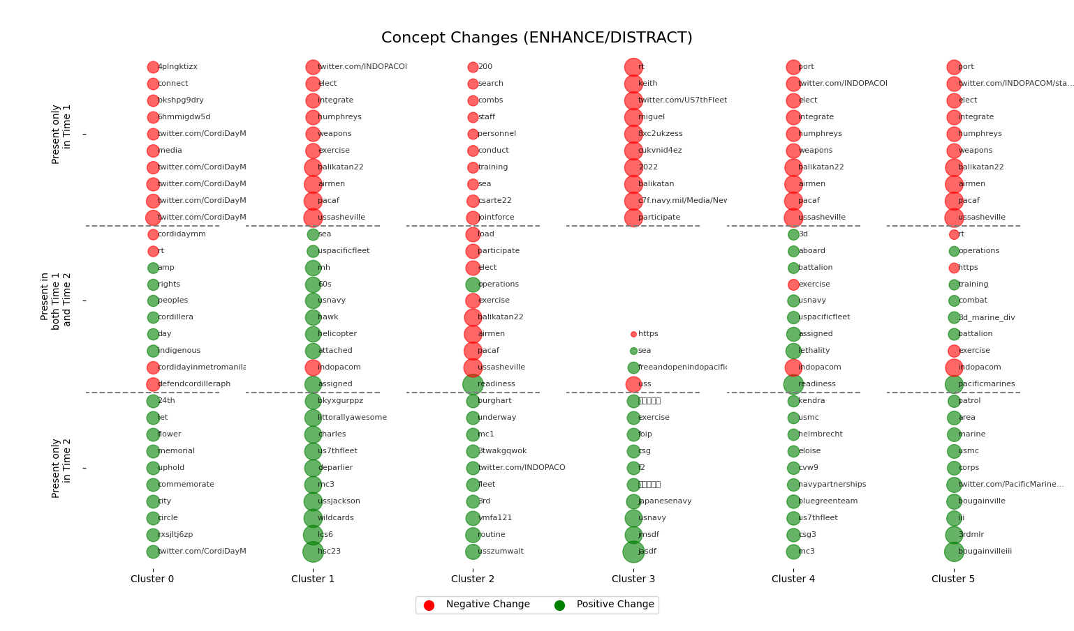
ENHANCE / DISTRACT
Notes:
Pie graph at the bottom of all

Slide 51
BEND-Effects
Name | Definition | Effects-Based Detection
Back | Discussion or actions that increase the actual, or the appearance of, an actor’s importance or effectiveness relative to a community or topic | Measures: Centrality across all three – PageRank, Out Degree Centrality (ORA Style), Modularity/Vitality Hub* Network(s): Agent x Agent (Strong Ties)
Negate | Discussion or actions that decrease the actual, or the appearance of, an actor’s importance or effectiveness relative to a community or topic
Build | Discussion or actions that create a group, or the appearance of a group, where there was none before | Measures: TOG Cluster agent composition
Narrow | Discussion or actions that lead a group to be, or appear to be, more specialized, and possibly to fission, or appear to fission, into two or more distinct groups
Bridge | Discussion or actions that build a connection between two or more groups or create the appearance of such a connection | Measures: Meta-node (TOG Community) ties Network(s): Agent x Agent (Strong Ties union Concepts)
Neutralize | Discussion or actions that cause a group to be, or appear to be, no longer of relevance, e.g., because it was dismantled
Boost | Discussion or actions that increase the size of a group and/or the connections among group members, or the appearance of such | Measures: Average Path Length Network(s): Agent x Agent (Strong Ties)
Neglect | Discussion or actions that decrease the size of a group and/or the connections among group members, or the appearance of such

Slide 52
BEND-Effects
Name | Definition | Effects-Based Detection
Excite | Discussion or actions related to a community or topic that cause the reader to experience a positive emotion such as joy, happiness, liking, or excitement | Measures: Messages of TOG Cluster agents in t2 and in t1 – evaluate for 4 positive/negative CUEs through NetMapper
Dismay | Discussion or actions related to a community or topic that cause the reader to experience a negative emotion such as worry, sadness, disliking, anger, despair, or fear
Explain | Discussion or actions that clarify a topic to the targeted community or actor often by providing details on, or elaborations on, the topic | Measures: Average Path Length Network(s): Concept x Concept (Agents in TOG)
Distort | Discussion or actions that obscure a topic to the targeted community or actor often by supporting a particular point of view or calling details into question
Engage | Discussion or actions that increase the relevance of the topic to the reader often by providing anecdotes or enabling direct participation and so suggesting that the reader can impact the topic or will be impacted by it | Measures: A) 1st Person pronoun usage, 2) Defining Concept usage (Defining Concepts are those concepts found in both time 1 and time 2) Network(s): Messages (NetMapper CUEs), Agent x Concept
Dismiss | Discussion or actions that decrease the relevance of the topic to the reader often by providing stories or information that suggest that the reader cannot impact a topic or be impacted by it
Enhance | Discussion or actions that provide material that expands the scope of the topic for the targeted community or actor often by making the topic the master topic to which other topics are linked | Measures: Proportional change of concept usage of Defining Concepts (concepts found in both time 1 and time 2 Network(s): Concept x Concept (Agents in TOG)
Distract | Discussion or actions that redirect the targeted community or actor to a different topic often by bring up unrelated topics, and making the original topic just one of many

Slide 53
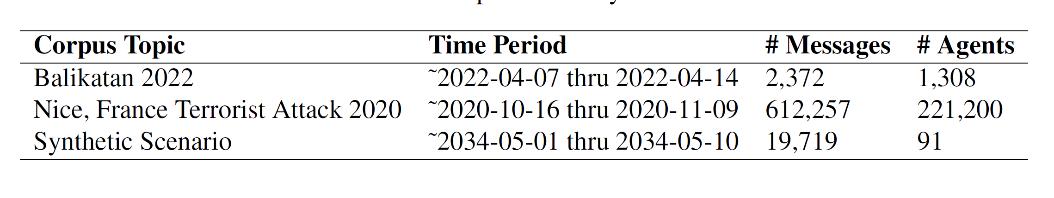
Case Studies

Slide 54
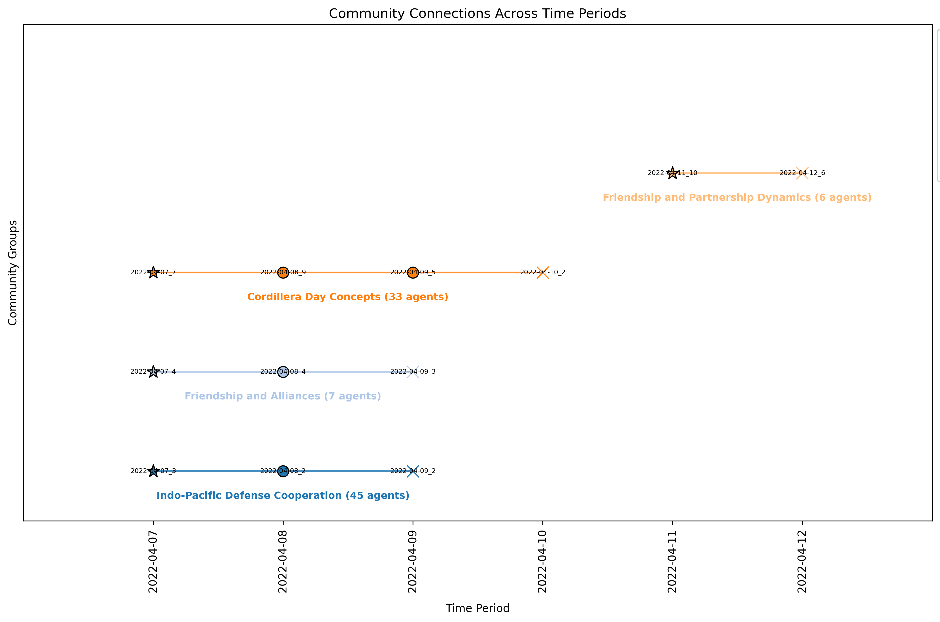
Balikatan 22
X/Twitter pull from 07 April – 14 April 2022.
Balikatan is an annual bilateral military exercises between the US and the Philippines. In 2022, it ran from 28 March to 08 April and coincided with the 75th anniversary of U.S.-Philippine security cooperation.
4 communities found - LLM auto-summarized a name for each community using group concepts

Slide 55
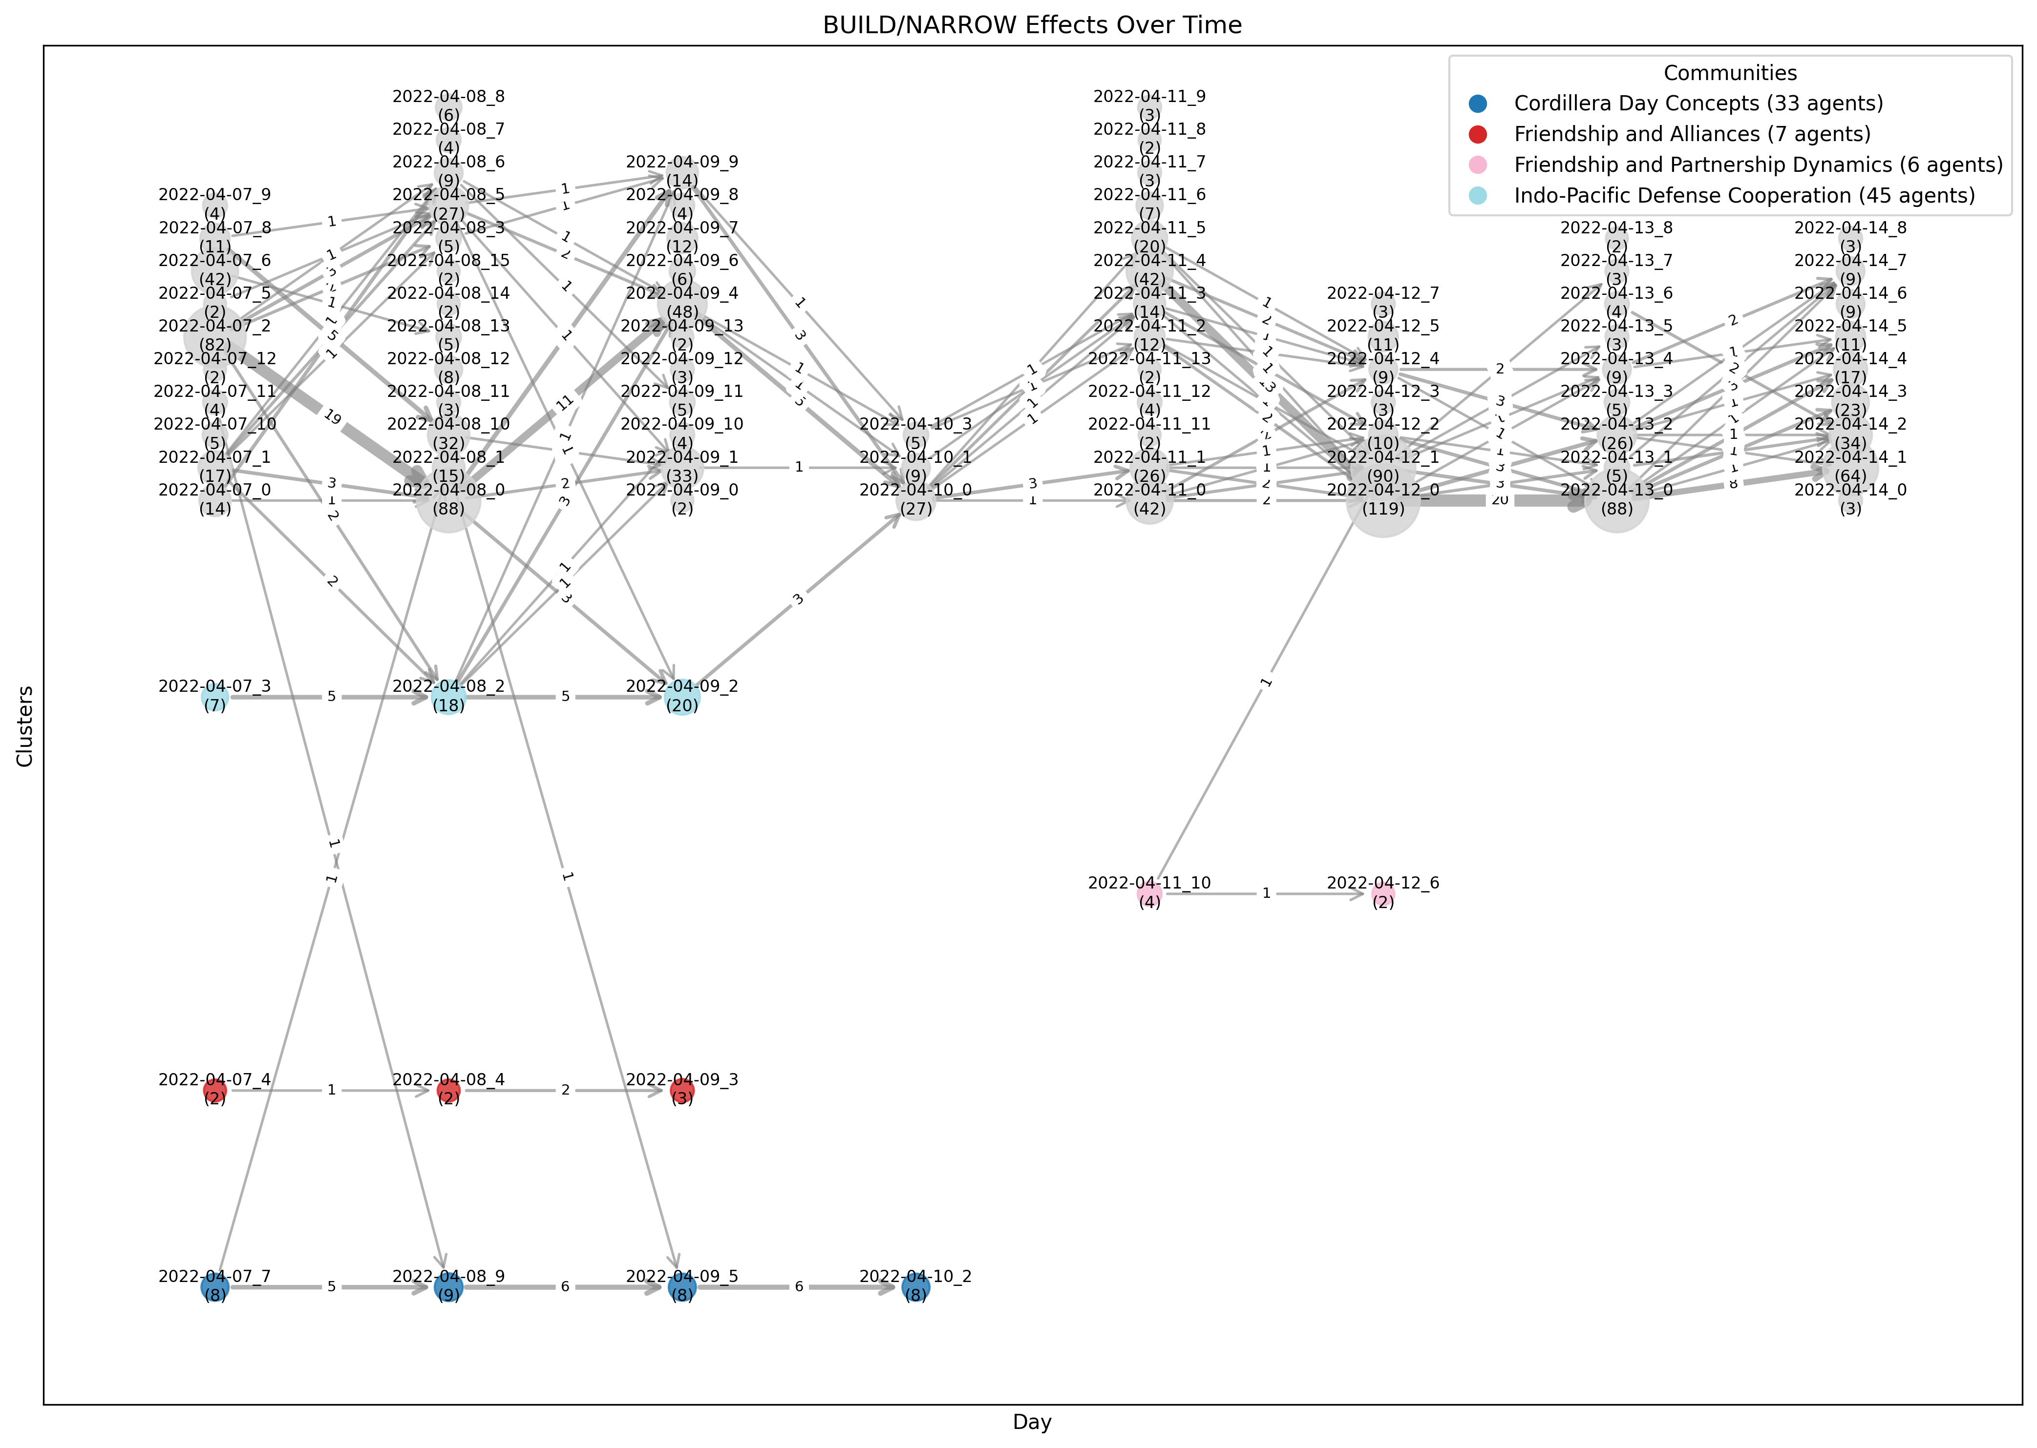
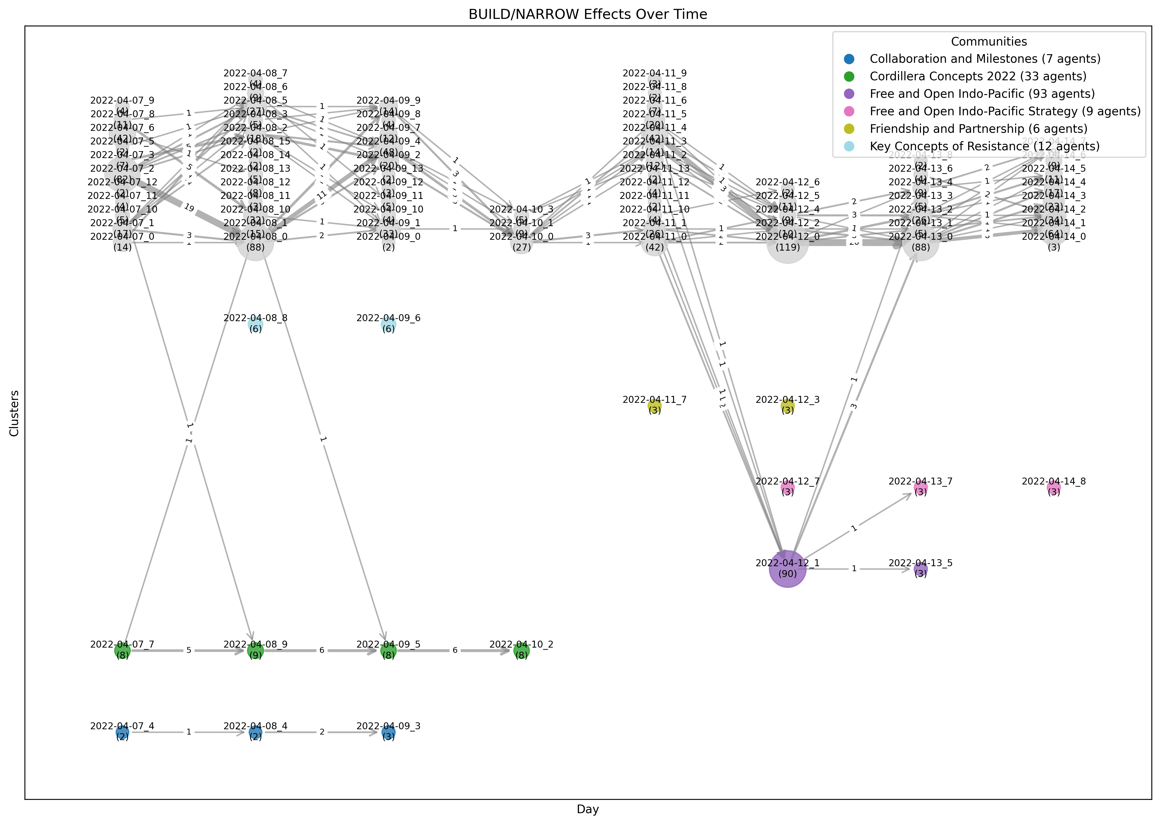
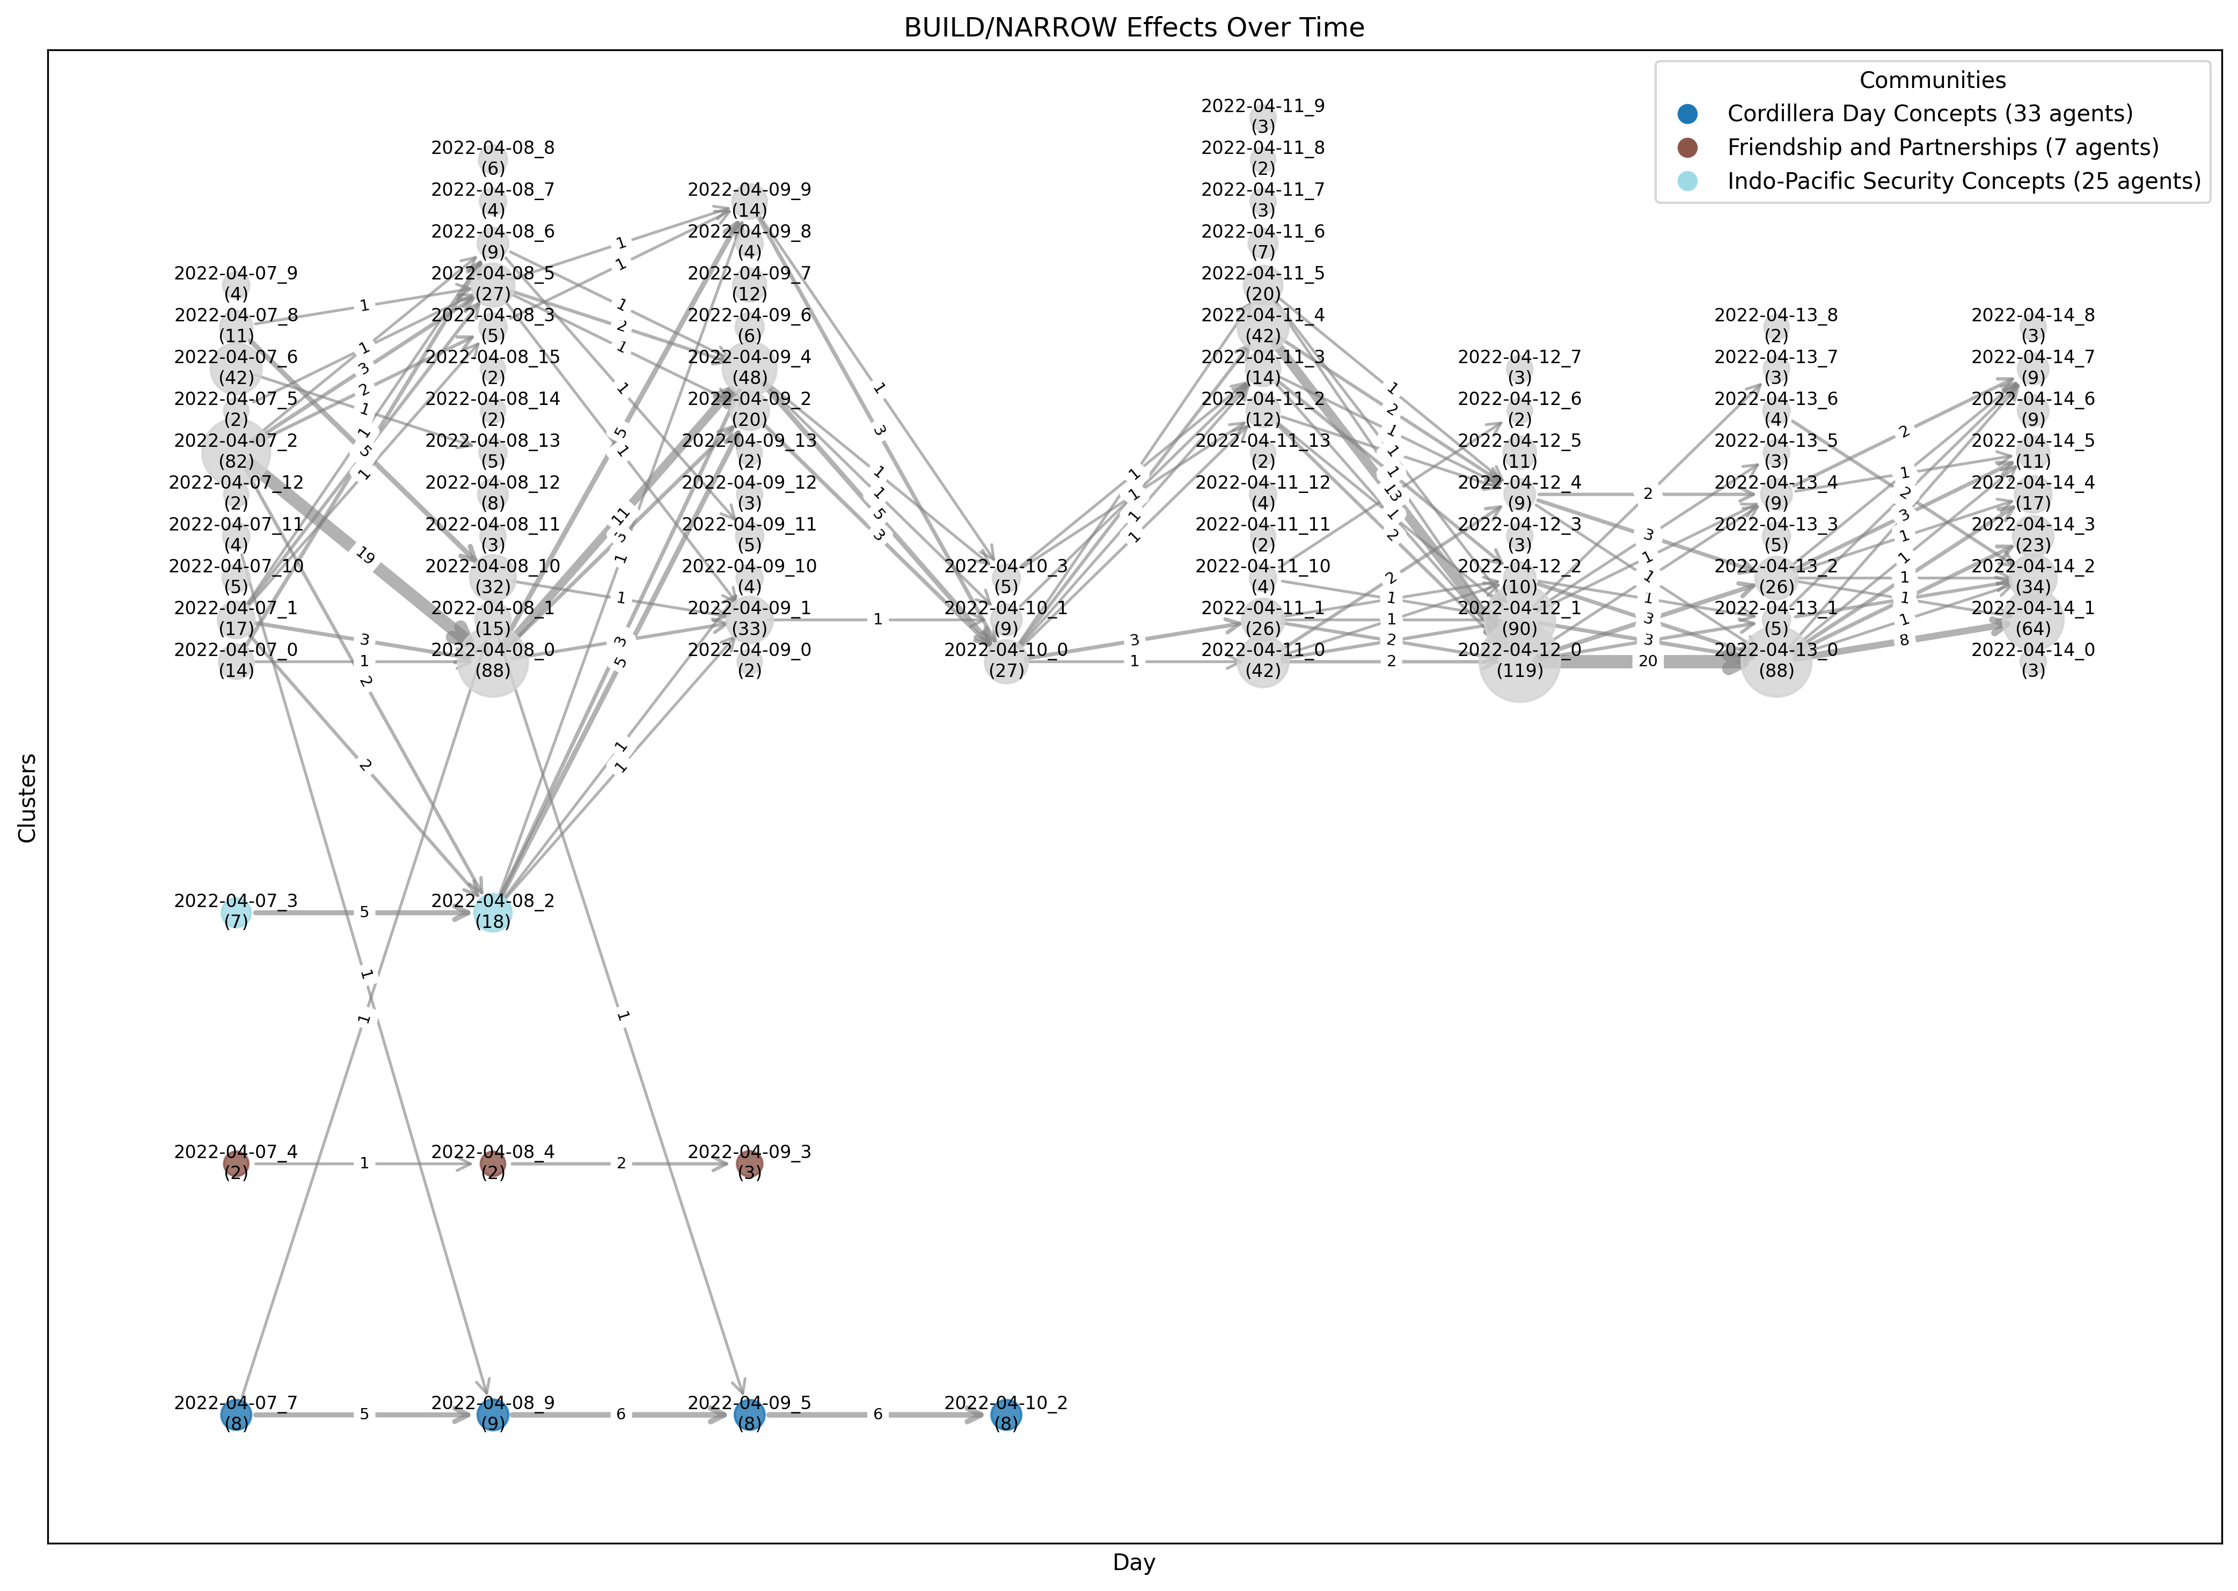
Balikatan 22 (BUILD/NARROW)
Adjusted Rand Index
Normalized Mutual Information

Slide 56
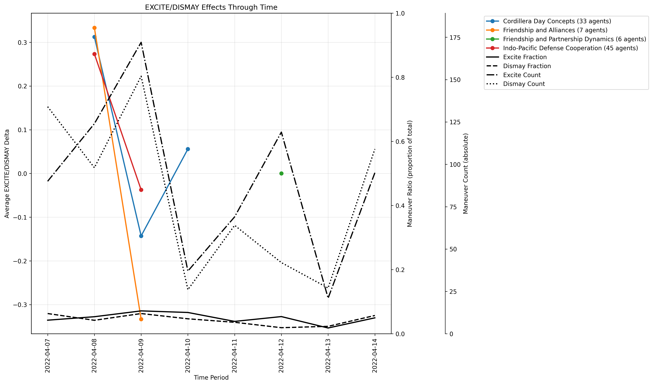
Balikatan 22 (EXCITE/DISMAY)
Dismay effects coincide with the end of the exercise
Acceleration vs speed

Slide 57


Balikatan 22 (ENGAGE/DISMISS)
The Cordillera are an indigenous people in the Philippines who commemorate the 1980 killing of a tribal chieftain with Cordillera Day each year on 24 April.

Slide 58


Balikatan 22 (ENHANCE/DISTRACT)
Balikatan22
kordilyeraagkaykaysa2022

Slide 59

French Terror 2020
X/Twitter pull from 26 October – 04 November 2020.
The actual terror attack - in which three people were stabbed to death by a Tunisian man at Notre-Dame de Nice - occurred on 29 October 2020. However, the event was surrounded by the Charlie Hebdo Terror trial (September through December 2020) and was preceded by several weeks of protests around the Muslim world, a Turkish boycott of France, and the beheading of a French history teacher on 16 October 2020. 47 communities
14 communities > 2-day duration

Slide 60
French Terror 2020 Timeline
2015
7 January – Charlie Hebdo Attacks (12 killed)
8 January – Shooting (1 killed)
9 January – Multiple sieges (4 killed)
13 November – Paris attacks (130 killed)
2016
14 July – Nice truck attack (86 killed)

Slide 61
French Terror 2020 Timeline
2020
01 September – Charlie Hebdo republishes caricatures
02 September – Charlie Hebdo trial begins
25 September – Stabbings outside Charlie Hebdo
02 October – “Islam is a religion that is in crisis all over the world today…” – French President Macron
16 October – Samuel Paty beheaded (1 killed)
21 October – “We will not give up cartoons, drawings, even if others back down…” – French President Macron
24 October – Turkish President Erdogan calls for Islamic boycott of France
27 October – Charlie Hebdo published cartoons mocking President Erdogan
28/29 October – Mawlid
29 October – Notre-Dame de Nice Stabbing (3 killed)
29 October – “France will not give in to terror…” – French President Macron
29 October – Turkey condemns terror attack
31 October – Macron interview with Al-Jazeera accuses Erdogan of “imperial inclinations”
01 November – Anti-French protests in Pakistan, India, Turkey
Notes:
02 November Memorial Service for Samuel Pary

Slide 62

French Terror 2020 (BACK/NEGATE)
Increase in spread immediately following the attack
And again, days later after comments by Macron
Notes:
Super Spreaders are those agents that produce documents that are shared often by others. Super Friends are agents that often exhibit two-way communication patterns. General Influencers are agents that have high follower counts and are retweeted/mentioned by those with high follower counts. For Eigenvector Centrality an agent's centrality is based upon the centrality of its neighbors.

Slide 63

French Terror 2020 (ENHANCE/DISTRACT)
macronsaysorrytomuslims
shameonyoumacron
macronpsycho macrongonemad
macron macronthedevil

Slide 64

French Terror 2020 (BOOST/NEGLECT)
Charlie Hebdo Incident
(09 JAN 2015)
A large bump during the lead up to the 29 October attack – trial discussions
The group was then severely neglected after Nice stabbings and disappeared

Slide 65

Synthetic Dataset
Synthetic (fake) X/Twitter dataset from 01 May – 10 May 2034 built using a scenario created in AESOP.
Events:
Balikatan 2034, Arctic and South China Sea confrontations, a typhoon, weather/spy balloons, ship and aircraft collisions, student protests – building toward a broader kinetic conflict on 10 May 2034. 6 communities

Slide 66


Synthetic Dataset (BRIDGE/NEUTRALIZE)
2034-05-06 to 2034-05-07
Current Global Issues
0.97
Geopolitical Tensions Overview
Indo-Pacific Security
Concerns
-0.68
Geopolitical Tensions and Protests

Slide 67

Synthetic Dataset (BRIDGE/NEUTRALIZE)
2034-05-06 to 2034-05-07
Geopolitical Tensions Overview
0.47
Geopolitical Tensions and Protests

Slide 68

Synthetic Dataset (ENHANCE/DISTRACT)
portshutdown
cyberattack
portshutdown
readiness
warprep
url…
pacificpeace
worldpeace
09 May 2034
Cyber attack shuts down ports
10 May 2034
Highly increased tensions between major powers
Duchess (Lord Privy Seal) tours the area
duchyes
duchess

Slide 69
Conclusion
Theoretical and Methodological contributions
BEND effects-based detection, which in conjunction with CUE+ allows for a more comprehensive detection mechanism
SynTel/X combine traditional simulation logic with LLM-powered message construction to
Application contributions
AI-enabled social media scenario development from existing exercise material or corpora
A draft data standard for passing social media objects and scenarios
AI-enabled X/Twitter and Telegram social media generation for exercise training based on synthetic templates
Notes:
\section{Methodological Contributions}
This dissertation also presents several original methodological contributions, advancing both detection capabilities and synthetic scenario generation tools for influence operations.
\subsection{Effects-Based Detection of BEND Maneuvers}
A major methodological advancement of this thesis is the development of an effects-based approach to detecting BEND maneuvers. Unlike previous detection methods that sought to infer intent from content and contextual signals (e.g., CUE+), this approach directly measures the observable effects of a maneuver within a social network or narrative ecosystem. This methodological shift enables:
\begin{itemize}
\item More objective and replicable assessments of maneuver effectiveness
\item Better integration with automated systems, reducing reliance on subjective human judgment
\item Improved post hoc analysis, allowing planners to evaluate whether an observed maneuver actually achieved its intended influence
\end{itemize}
This framework, in conjunction with CUE+ methods, enables comprehensive detection and empirical assessment of influence maneuvers.
\subsection{SynTel and SynX: Agent-Based Social Media Generators}
This thesis also introduces SynTel and SynX, two agent-based social media generators developed for Telegram and Twitter/X respectively. These tools provide:
\begin{itemize}
\item Traditional simulation logic, which models agent behaviors and interactions
\item LLM-powered message construction, generating realistic, contextually appropriate content
\item Enhanced scenario realism, ensuring that generated training exercises reflect real-world influence dynamics
\item Scalable dataset creation, reducing the manual effort required for scenario design
\end{itemize}
By integrating these capabilities, SynTel and SynX enable the creation of synthetic social media datasets that reflect real-world influence dynamics. These tools provide researchers and practitioners with a controlled yet flexible means of simulating social media influence campaigns in a training or analytical environment.
\subsection{AESOP: AI-Enabled Scenario Orchestration and Planning}
A final methodological innovation is AESOP (AI-Enabled Scenario Orchestration and Planning). AESOP is a planning tool that allows Information Environment planners to:
\begin{itemize}
\item Develop social-cyber exercise scenarios from scratch
\item Integrate social-cyber vignettes into existing scenarios
\item Rapidly generate narrative-driven influence operations training material
\end{itemize}
\section{Application Contributions}
Beyond its theoretical and methodological impact, this research also contributes practical applications:
\begin{itemize}
\item AI-enabled social media scenario development, allowing exercise designers to generate realistic social media narratives from existing datasets or training material
\item A draft data standard for social media-based scenario exchange, providing structured interoperability for synthetic data sharing
\item Synthetic social media generation for X/Twitter and Telegram, enabling automated creation of training datasets for influence operations exercises
\end{itemize}

Slide 70
Conclusion
AESOP reduces the time required for social media scenario design from months to days
SynTel/X produces realistic, interactive X and Telegram datasets based on AESOP scenarios (~1,000 messages/minute)
BEND-Effects allows analysts to find BEND maneuvers based on their effects within a dataset and assess the effectiveness of BEND maneuvers

Slide 71
Limitations and Justifications
BEND Framework Improvements
Additional methods for measuring BEND maneuvers above baseline are required – residual statistics will be more important than net maneuver counts
Finding topic-oriented groups through time remains a difficult process
There is currently no method for directly associating observed BEND effects with any single message BEND maneuver
BEND Scenario Development
Without a population model in the simulation, agent opinions remain static; however, AESOP training is not static as training audience decisions and actions impact all additional synthetic data
Training data should always be a snapshot of the full picture as most social media APIs do not allow for decisively pulling all data possible

Slide 72
Funding and Disclaimer
The research for this thesis was supported in part by the Office of Naval Research (ONR) under grant N00014182106, the United States Army under grant W911NF20D0002, and the center for Informed Democracy and Social-cybersecurity (IDeaS). The views and conclusions are those of the authors and should not be interpreted as representing the official policies, either expressed or implied, of the ONR, the United States Army, or the US Government.
The appearance of U.S. Department of Defense (DoD) visual information does not imply or constitute DoD endorsement.

Slide 73
Questions

Slide 74
BACKUP SLIDES

Slide 75
Future Work (BEND-Effects)
Each of the maneuver metrics for BEND-effects currently lacks proper thresholding and significance measures. While the existence of maneuver effects is firmly established, their degree of importance remains left to the interpretation of the analyst. This is the difference between evidence of bridging and evidence of bridging that we care about.
Additionally, alternatives to Leiden should be explored as finding topic-oriented groups is not a solved problem. The BEND-effects calculations could also be better expressed by first calculating a baseline of the entire corpus at each time period of the given metric and then expressing and individual clusters change over time as a residual above and beyond the baseline. This would help ensure the BEND-effect measurement for a cluster is greater than chance and is not a byproduct of a global effect.
Finally, with BEND-effects we know what effects were felt by communities and with the traditional cue-based BEND detection we can predict what communities intended to do - the logical next step is to map the one to the other. We can plot each community's experienced effect against the intended effects of all other community and in this way attempt to draw conclusions about which intended maneuver campaigns were effective.

Slide 76
Future Work (SynTel/X)
First, the agents in the current model have opinions matrices that map their stance on each topic in the scenario; however, there is currently no population modeling implemented to feed these matrices nor is there information diffusion implemented such that theses stances change over time. Thus, while the actors respond in accordance with their opinions, the simulation is currently a perfect model of arguing on Internet forums - no one ever changes their mind.
Furthermore, more validation should be done. If the goal is simply to train on BEND maneuver detection and response, then the current validation network metrics and BEND evaluations show that SynX is sufficient. However, training and instruction on other aspects of social networks might require additional, unevaluated, network properties. This includes more research into matching the Agent x Agent modularity against real world datasets.
Finally, work is also required within the BEND evaluations. While the AESOP scenario comes with images and news sites, the current ORA-Pro and NetMapper BEND evaluation is done only on the meta-data and the text. Future detection should include an evaluation of the included images or referenced URLs.

Slide 77
Future Work (AESOP)
AESOP should be tied with retrieval-augmented generation (RAG) to limit hallucinations and provide additional support to the mad-lib method of prompt-engineering used to scaffold the planner. RAG would allow planners to rely upon a corpus of validated material to supplement the LLMs trained knowledge.\cite{lewis2020rag}
AESOP should integrate the ability to populate personas drawn from population modeling of a demographic. This would provide an effective method for determining the types of personas that are representative of a demographic, rather than relying upon the planner to select and fill these attributes by hand.
AESOP should allow for the quick integration of multiple LLMs for specialized purposes. Currently, the LLM is set at the global level within AESOP and this pushes AESOP toward using large generalized models - favoring commercial models over local LLMs. The ability for AESOP to operate with purely local LLMs does already exists but specifying multiple, smaller, specialized LLMs for agent creation versus journal/article writing versus press releases would increase quality while still allowing for disconnected operation.

Slide 78
ENGAGE / DISMISS
Name | Definition | Detect
Engage | Discussion or actions that increase the relevance of the topic to the reader often by providing anecdotes or enabling direct participation and so suggesting that the reader can impact the topic or will be impacted by it | Target: Each Agent per TOG Community Measures: A) 1st Person pronoun usage, 2) Defining Concept usage (Defining Concepts are those concepts found in both time 1 and time 2) Network(s): Messages (NetMapper CUEs), Agent x Concept Indicator: A) Increase, B) Increase
Dismiss | Discussion or actions that decrease the relevance of the topic to the reader often by providing stories or information that suggest that the reader cannot impact a topic or be impacted by it | Indicator: A) Decrease, B) Decrease
Per Actor
Per Actor
Defining Concepts
A
1st Person: 2
A
1st Person: 20
A
B
A
A
B
1st Person: 2
B
1st Person: 20
A
B
C
C
1st Person: 2
A
B
C
1st Person: 20
D
1st Person: 2
D
1st Person: 20
C
C
Time 1
Time 2

Slide 79

ENGAGE / DISMISS

Slide 80
BACK / NEGATE
Name | Definition | Detect
Back | Discussion or actions that increase the actual, or the appearance of, an actor’s importance or effectiveness relative to a community or topic | Target: All Agents Measures: Centrality across all three – PageRank, Out Degree Centrality (ORA Style), Modularity/Vitality Hub* Network(s): Agent x Agent (Strong Ties) Indicator: Positive change from t1 to t2
Negate | Discussion or actions that decrease the actual, or the appearance of, an actor’s importance or effectiveness relative to a community or topic | Indicator: Negative change from t1 to t2
Already present in ORA-PRO as super-spreaders: Posts Often (out-degree centrality) [Agent x Tweet - Sender]
Often Spread by Others (out-degree centrality) [Agent x Agent - All Propagation]
Iteratively Spread by Others (page rank centrality) [degreeType=outDegree] [Agent x Agent - All Propagation]
Often Spread by Groups of Others (member of large k-core) [degreeType=outDegree] [Agent x Agent - All Propagation]
Notes:
Picture
Over time
More than one effect
How to do Ensembler of more than one effect
Time period of effects bounded by Day? Month

Slide 81

BACK / NEGATE

Slide 82
EXCITE / DISMAY
Name | Definition | Detect
Excite | Discussion or actions related to a community or topic that cause the reader to experience a positive emotion such as joy, happiness, liking, or excitement | Target: TOG Communities Measures: Messages of TOG Cluster agents in t2 and in t1 – evaluate for 4 positive/negative CUEs through NetMapper Network(s): CUEs from NetMapper Indicator: Increase in positive CUEs
Dismay | Discussion or actions related to a community or topic that cause the reader to experience a negative emotion such as worry, sadness, disliking, anger, despair, or fear | Indicator: Increase in negative CUEs
A
☺
A
☺☺☺
A
☹
A
☹☹☹
1
B
☺
1
B
☺☺
1
B
☹
1
B
☹☹
C
☺
C
☺☺☺☺☺
C
☹
C
☹☹☹☹☹
Time 1
Time 2
Time 1
Time 2
Notes:
Count all pos and neg cues = total_cues
T2 pos/total – T1 pos/total = delta pos
T2 neg/total – T1 neg/total = delta neg

Slide 83

EXCITE/DISMAY

Slide 84
BRIDGE / NEUTRALIZE
Name | Definition | Detect
Bridge | Discussion or actions that build a connection between two or more groups or create the appearance of such a connection | Target: Each pair of TOG Communities Measures: Meta-node (TOG Community) ties Network(s): Agent x Agent (Strong Ties union Concepts) Indicator: Increase from t1 to t2
Neutralize | Discussion or actions that cause a group to be, or appear to be, no longer of relevance, e.g., because it was dismantled | Indicator: Decrease from t1 to t2
1
2
1
2
2
2
1
1
3
4
3
4
3
4
3
4
Time 1
Time 2
Time 1
Time 2
Notes:
Picture
Over time
More than one effect
How to do Ensembler of more than one effect
Time period of effects bounded by Day? Month

Slide 85


BRIDGE / NEUTRALIZE
Notes:
Picture
Over time
More than one effect
How to do Ensembler of more than one effect
Time period of effects bounded by Day? Month

Slide 86
Data Standard
Standard (Acronym) | Purpose | Key Components | Primary Use Case | Data Format | Adoption | Website Reference
Structured Threat Information Expression (STIX) | Cyber threat intelligence, tracking actors, events, and campaigns | Identity, Threat Actor, Campaign, Incident, Observables | Tracking cyber threats, disinformation campaigns, and influence operations | JSON, XML | Cybersecurity, threat intelligence, law enforcement | https://oasis-open.github.io/cti-documentation/
Activity Streams 2.0 (AS2) | Social media activity representation | Actor, Object, Verb, Target, Group | Modeling social media interactions and behavioral dynamics | JSON-LD, ActivityStreams format | Decentralized social media platforms and Web3 applications | https://www.w3.org/TR/activitystreams-core/
Friend of a Friend (FOAF) | Describes social relationships and online identities | Person, Group, OnlineAccount, Knows | Semantic web applications and social network analysis | RDF (Resource Description Framework) | Semantic web, academic research, social network modeling | http://xmlns.com/foaf/spec/
Semantically-Interlinked Online Communities (SIOC) | Defines social media discussions and interactions | UserAccount, Post, Forum, Community, Topic | Online community tracking and engagement analysis | RDF, XML | Online discussion forums, enterprise knowledge management | https://web.archive.org/web/20220331224416/http://sioc-project.org/
Intelligence Community Information Resource Metadata (IC-IRM) | Intelligence metadata for information security, discovery, and analysis | Resource descriptions, classification, access control, XML/HTML encoding | Intelligence and national security data management | XML, HTML metadata | US Intelligence Community (IC) | https://www.dni.gov/index.php/who-we-are/organizations/ic-cio/ic-technical-specifications/information-resource-metadata
Unnamed Synthetic Social Media Scenario Data Standard (USS-MSDS) | Describes actors, events, groups, and narratives within a scenario | Actor, Account, Event, Group, Topic, Narrative, Article, URL | Communicating the structure and component of a social media scenario from the scenario planner to a synthetic generator | JSON | NONE | NONE
Notes:
https://resources.data.gov/standards/concepts/

Slide 87
Similarities to Meliorator
Meliorator – The US, the Netherlands, and Canada accused RT affiliates of using a sophisticated AI-enhanced software package to disseminate information to/about US, Poland, Germany, the Netherlands, Spain, Ukraine, and Israel
Brigadir GUI for Taras – “Souls” tab for false identities and “Thoughts” tab for scenarios and actions
Joint Cybersecurity Advisory: https://www.ic3.gov/CSA/2024/240709.pdf

Slide 88




Content: Is my dataset any good?
Are there realistic looking BEND maneuvers in the data?

Slide 89
Content: Is my dataset any good?
Are there realistic looking BEND maneuvers in the data?

Slide 90
Research Roadmap Timeline

Slide 91

Realistic Training
E
A
D
B
C
G
F

Slide 92
Telegram Generation
Per Hour
x3
Per Account
Calculate # Actions
Per Action
D
A
Get Narrative
Post
LLM
Check detected BEND against intended BEND
B
x10
Message Corpus
Get BEND Maneuvers
F
E
C
Cross post
Replace intended BEND
Notes:
Back – retweet, reply, quote, positive
Engage – retweet, reply, quote, urls
Neutralize – retweet, reply, quote, negative
Explain – urls
Negate - mentions
Bridge – mentions
Build – mentions
Boost – mentions
Preferential Attachment
Markov chain

Slide 93
AI-Enabled Scenario Orchestration and Planning (AESOP)
Rhetoric, Discourse, Narrative, Story
Group
Stance
Topic
URLs
Actor
BEND
Event
News
Twitter Account
Telegram Account

